Slide 1
Event plane and centrality determination
Lukáš Chlad^{1,2}
¹Nuclear Physics Institute of the CAS
²Faculty of Nuclear Sciences and Physical Engineering of the CTU

Slide 2
Disclamer
This is not intended to give full details on the subjects, sometimes I will refer to specific articles which I think explains much better the problematics.
Mainly I am looking for your questions :)

Slide 3
My background
Member of HADES since 2013 - TOF calibration - ECAL assembly - small data analysis of diamond START detector - participating in Low Level Data Analysis - physics analysis of kaon flow in Au+Au@1.23AGeV
Member of CBM since 2019 - Lambda simulation and data analysis with mCBM - PSD analysis -> FWALL development

Slide 4
CONTENT
Why we need to know them?
Centrality dependence of variables, Transverse flow measurement
Original PSD
How the PSD handled these issues, its strengths and weaknesses
Examples
HADES Forward Wall, STAR Event Plane Detector
Novel approach within CBM
First ideas how to go without PSD

Slide 5
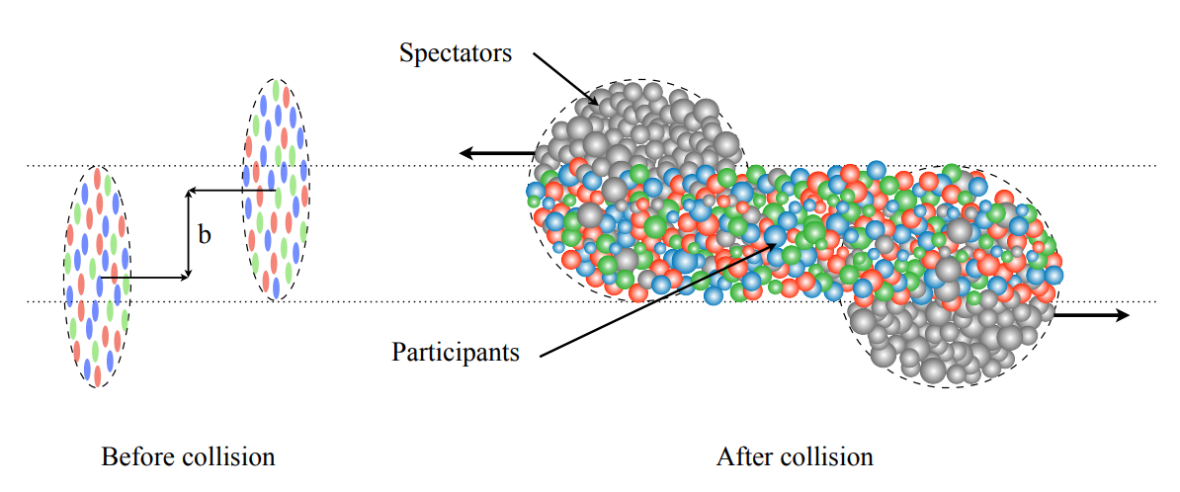
Heavy ion Collision
N_{spec} = A_{proj} +A_{targ} −N_{part}
N produced particles ~ N_{part} "wounded nucleon"

Slide 6
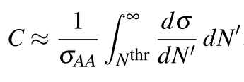
CENTRALITY
The centrality C is defined as the fraction of the total cross section σ_{AA} and is directly related to the impact parameter
EASY IN SIMULATION
IN REAL LIFE

Slide 7
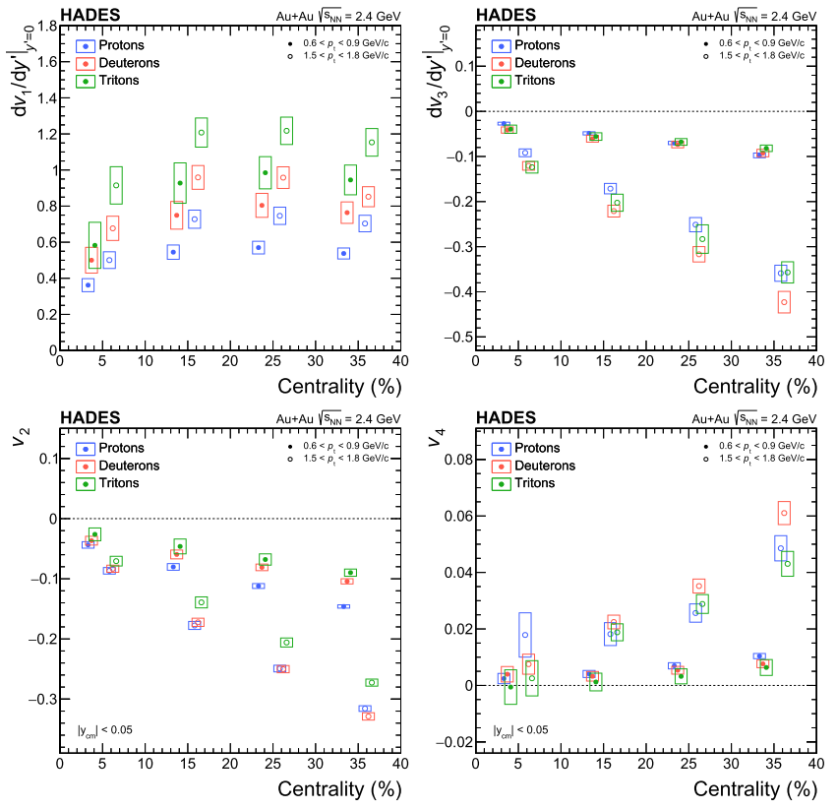
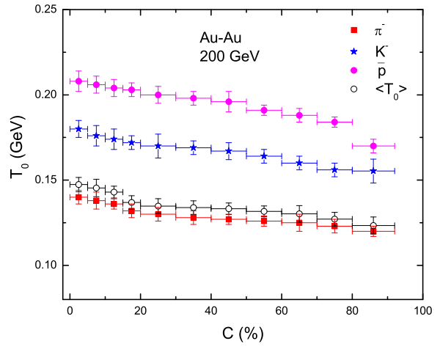
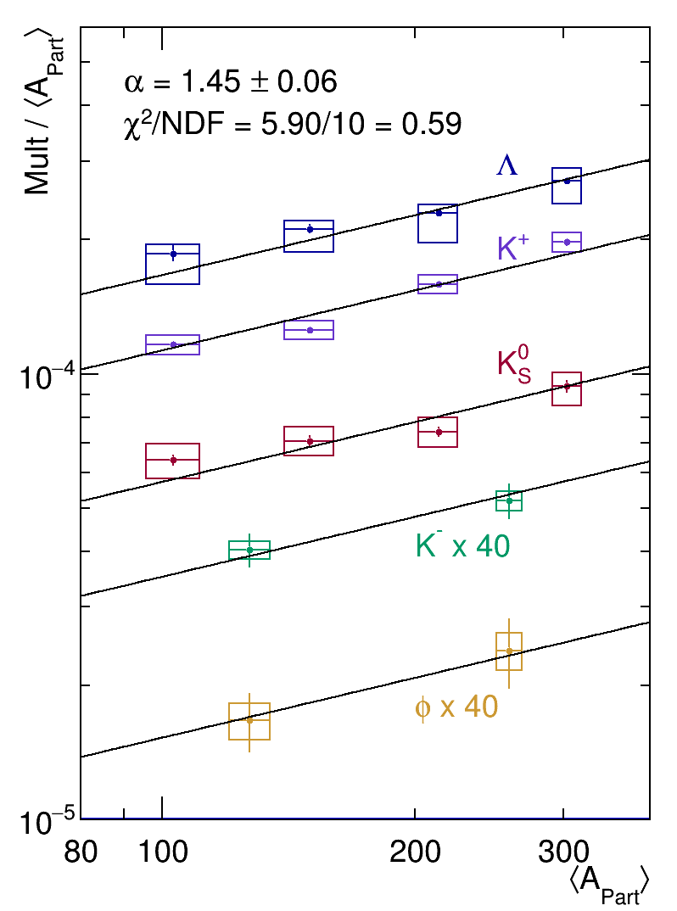
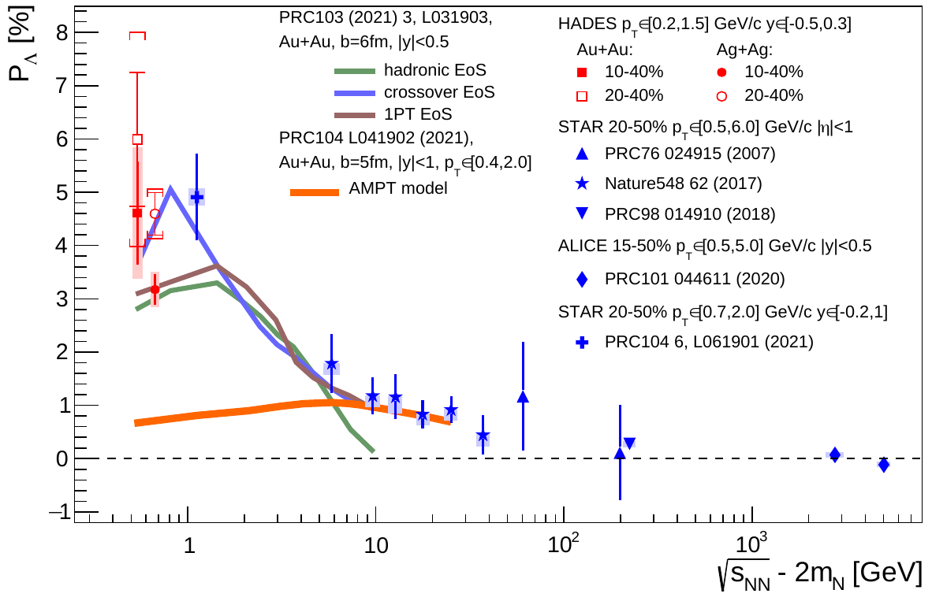
Why is centrality important
Many variables are highly dependent on the centrality: kinetic freeze-out temperature, multiplicity of produced particles, flow...

Slide 8
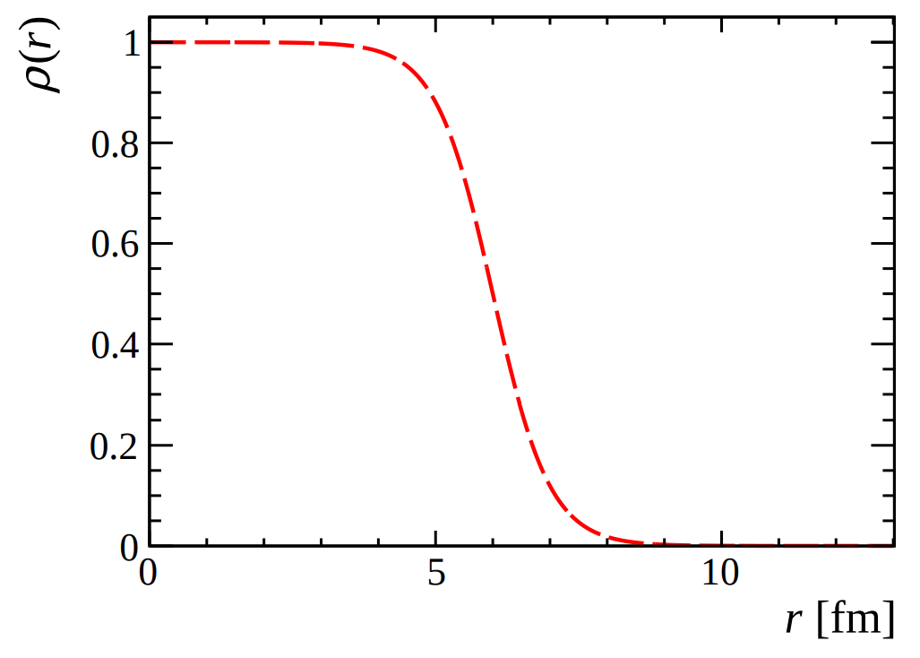
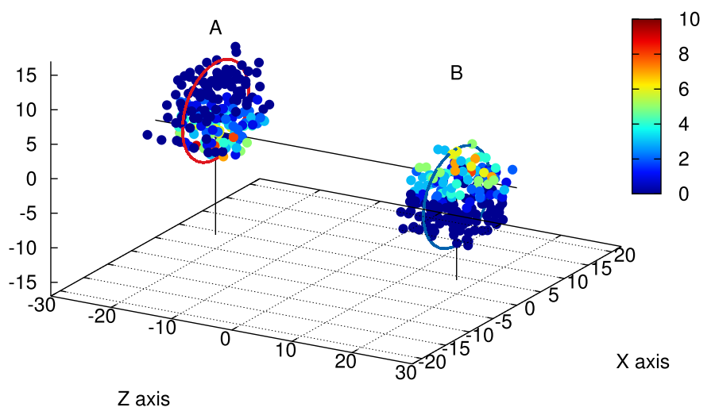
Glauber model
Optical
From geometrical overlaps of nucleus A and nucleus B with continuum distribution of density (e.g. Woods-Saxon)
Monte-Carlo
Nucleons represented by hard spheres around center (following WS distribution) plus assumptions:
AA collisions are superposition of NN collisions
Nucleons move along straight line (even if they have collided)
Decision if two nucleons collide based on transverse distance d² ≤ σ_{NN}^{inel} /π

Slide 9
How it works in SImulations

Slide 10
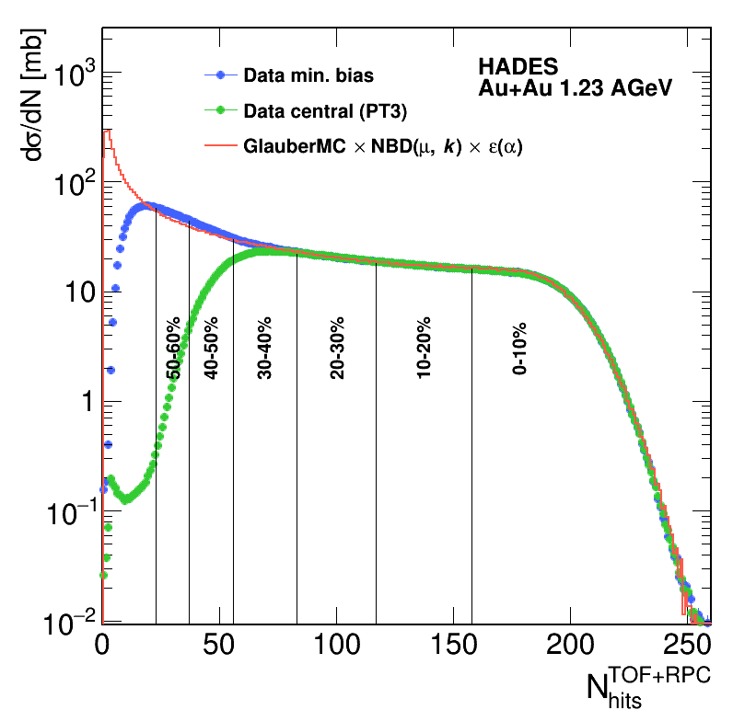
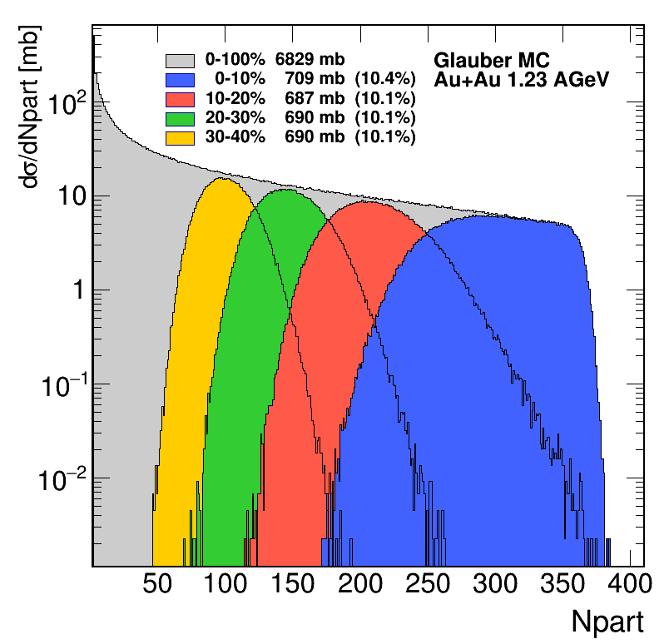
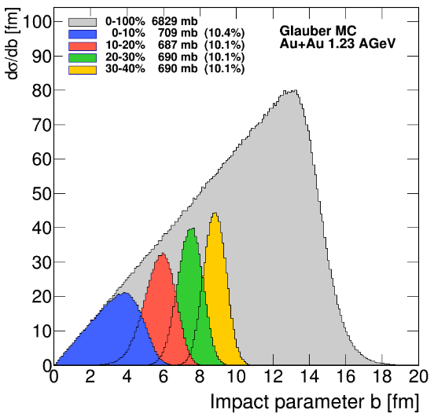
How it works in REAL LIFE
Negative Binomial Distribution allow event-by-event fluctuaction
Detection efficiency (dependent on occupancy of the detector)

Slide 11
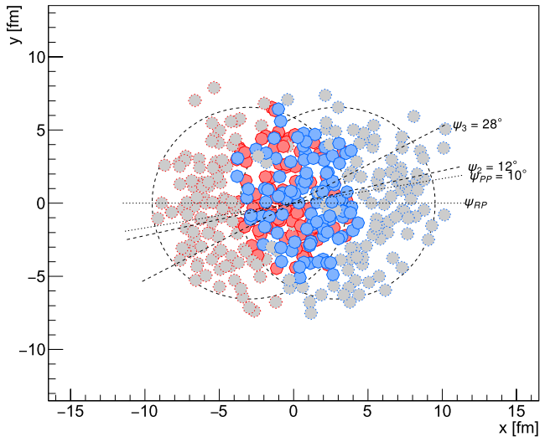
Reaction Plane
Ideally we would like to know "reaction plane" defined by vectors of beam direction and impact parameter => again not possible experimentally
Thus different techniques were developed to overcome this lack of knowledge in real life – one of which is so-called event plane.

Slide 12
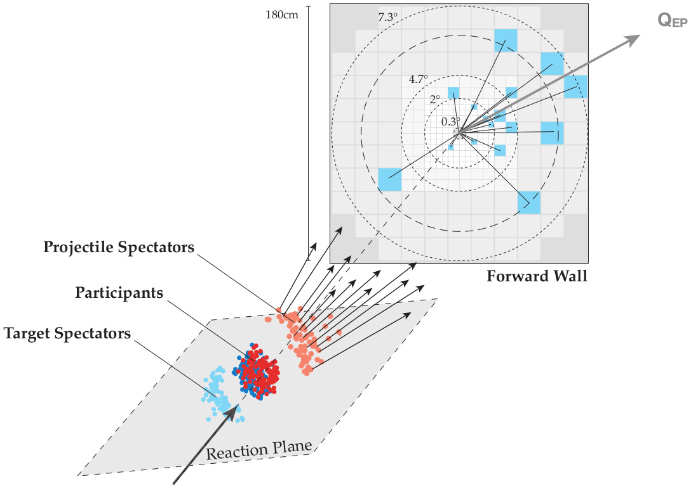
Event plane Ψ_{EP}=Ψ₁
advantages
Super easy to calculate with! Just trigonometry..
Proved technique over time (Poskanzer and Voloshin - PRC 58 (3): 1671–1678. 1998)
disadvantages
Not really good for very high multiplicities (in thousands like ALICE) => systematically underestimate the elliptic flow => cumulants are prefered (A. Bilandzic et al. - PRC 89 (6): 064904. 2014)

Slide 13
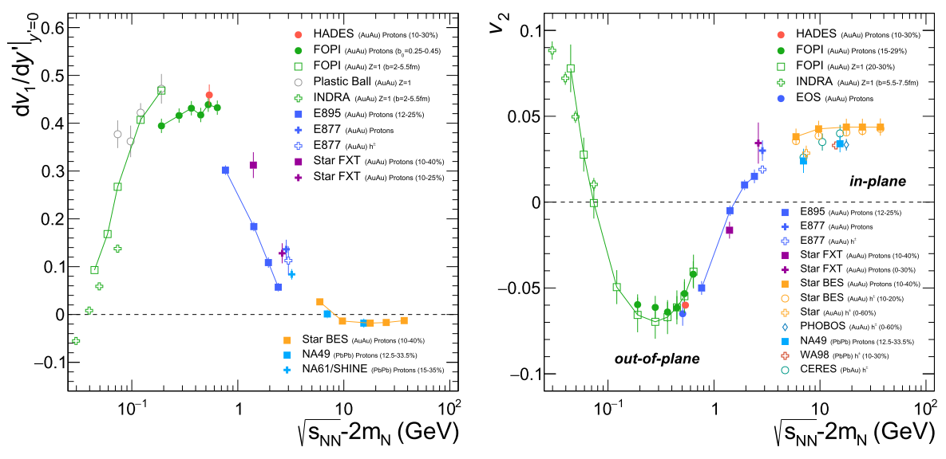
Transverse flow
In general, we are interested where the produced particles go :) Why focus on transverse direction? With increase energy of ccollision, the longitudinal direction is uch larger and just misleads us.
"parents" of the idea Danielewicz & Odyniec (PLB 157 (2-3) 146-150. 1985)
Is studied in great details for all particle species and energies!

Slide 14
Transverse flow
It is important to also disentangle the direction of flow of particles we are interested in and those which we use for EP determination!
Definition
BUT there is the reaction plane which is not accessible in experiments!
Transverse => w=p_{T}
The imprecision coming from using EP instead of RP leads to correction:

Slide 15
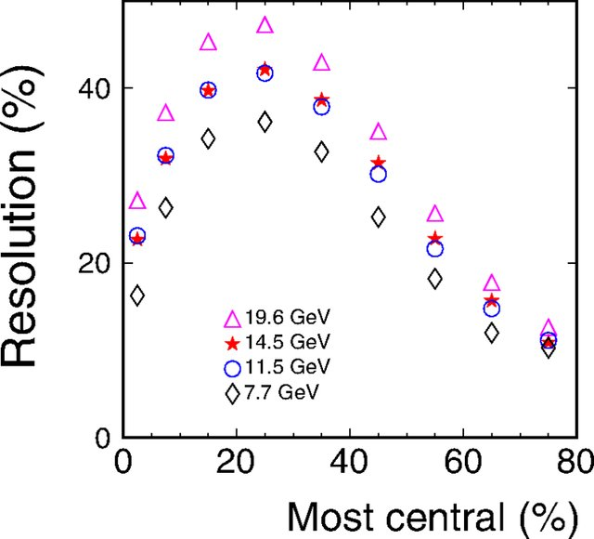
EP resolution correction
STAR: 10.1103/PhysRevC.93.014907
Analytically can be derived:
From "2-subset" technique (random division of detections into 2 subsets)
Leads to:
Method by Jean-Yves Ollitrault [arxiv:nucl-ex/9711003]

Slide 16
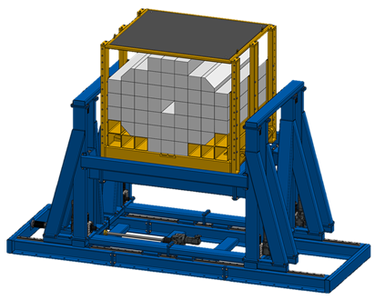
Projectile spectator detector
"The main purpose of the PSD is to provide an experimental measurement of a heavy-ion
collision centrality and orientation of its symmetry plane. Precise event-by-event estimate of these basic
observables is crucial for many physics phenomena studies to be performed by the CBM Collaboration.
The PSD is a compensating lead-scintillator calorimeter* designed to measure the energy distribution
of the projectile nuclei fragments (spectators) and forward going particles produced close to the beam
rapidity. "
*compensating means the same respons to electromagnetic and hadronic shower, using the sandwich Pb/Scint ratio 4:1

Slide 17
Design
44 modules
Design Requirements
How to fullfill them?
Spectators detection in the beam energy range of E_{b} = 2 − 35 AGeV.
Operation at beam intensities up to 10⁹ Au ions per sec.
Reaction plane determination with an accuracy better than 40 degree.
Determination of collision centrality classes with an accuracy better than 10%.
Large area ~ 1.5x1.5 m²
σ_{E}/E < 60%/sqrt(E[GeV])
Granularity 20x20 cm² (4 times smaller module size did not have significant improvement on EP resolution)
Radiation hard photon detector with high-rate capability (Micro-Pixel Avalanche Photodiod)
60 Pb+Scint pairs divided into 10 individually read-out sections
~ 6 interaction lengths

Slide 18
Performance in sim
Centrality determination
Event plane resolution

Slide 19
Performance @ NA61
Energy resolution
centrality
Event plane resolution
https://doi.org/10.22323/1.347.0195
https://doi.org/10.1016/j.nuclphysa.2018.10.058

Slide 20
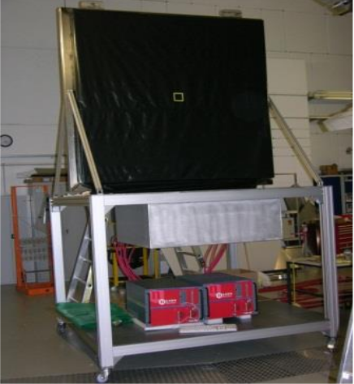
HADES FORWARD WALL
Located 7m downstream from the target region (polar angle between 0.33° and 7.17°)​
Linear dependence of signal amplitude ​on fragment charge

Slide 21
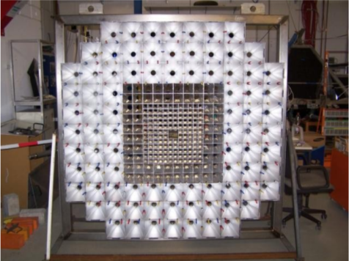
Design
Scintillator hodoscope (depth ~2.5 cm) 140 small cells (4x4 cm²)
64 middle cells (8x8 cm²)
84 large cells (16x16 cm²)
Instruments and Experimental Techniques 57 (2): 103-119. 2014

Slide 22
Performance
Time resolution
Freagment charge identification

Slide 23
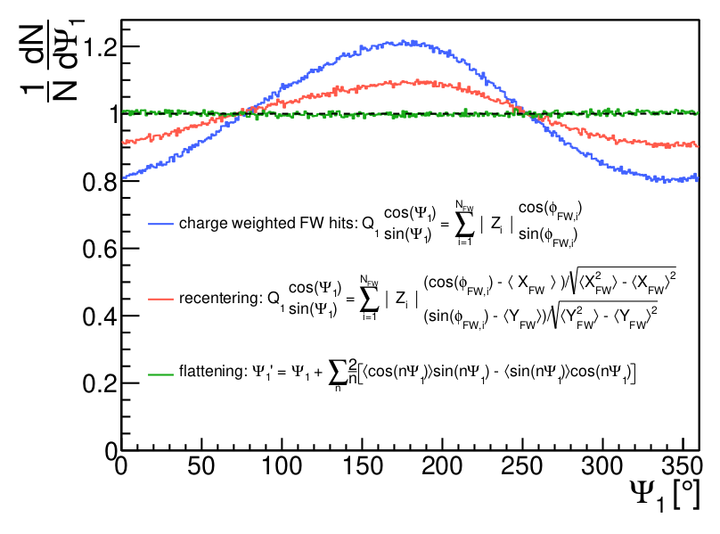
Event plane determination
Effects of non-uniform acceptance / tilt of beam PRC 77 (2008) 034904

Slide 24
Centrality determination
Usually, HADES is using N_{hit} as a variable defining the centrality classes
But in case of (net)proton number fluctuation one needs to avoid as much autocorrelations as possible.
It is to define centrality classes in terms of bins of summed charges in FWall.
https://doi.org/10.1103/PhysRevC.102.024914

Slide 25
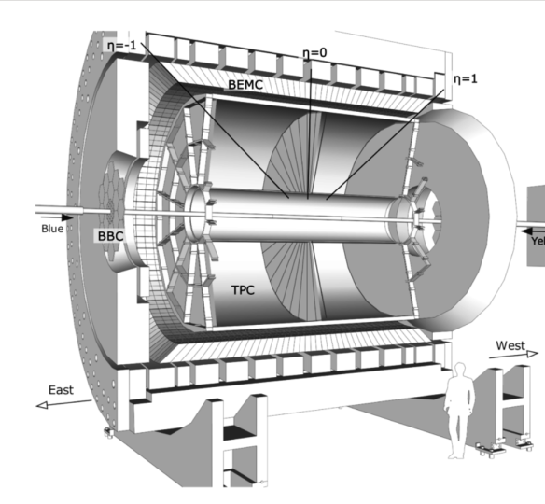
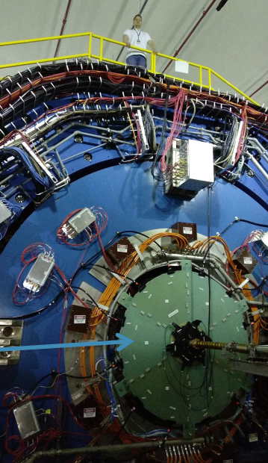
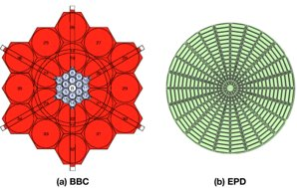
Event plane detector @ STAR
Replaced original BBC in 2017 (within STAR forward physics upgrade)
Measures charged particles emitted in the forward and backward directions, at angles 0.7◦ < θ < 13.5◦
https://doi.org/10.1016/j.nima.2020.163970

Slide 26
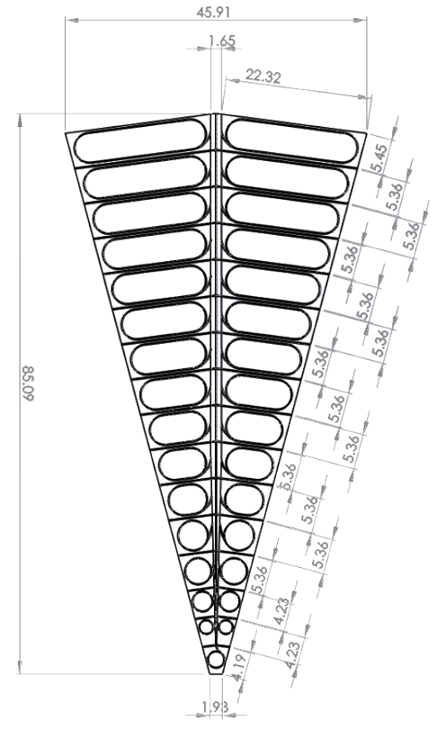
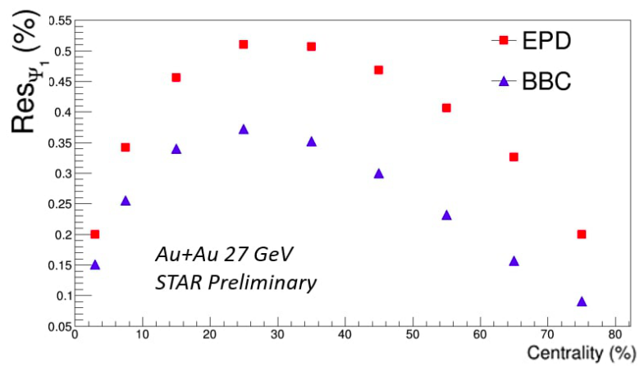
Design
Replacement of original BBC
Inner structure
Of EPD
Beam to Beam Counter used for multiplicity measurement (was used for triggering purposes)
In principle could be as well used to determine EP but with quite bad resolution
12 supermodules (1 is highlighted in figure) covering 30 deg. divided into 31 cells, disk radius 0.9m, hole of 4.6cm
1.2cm thick plastic scintillator read-out with wavelength shifter and optical fiber which that guides the light to SiPM

Slide 27
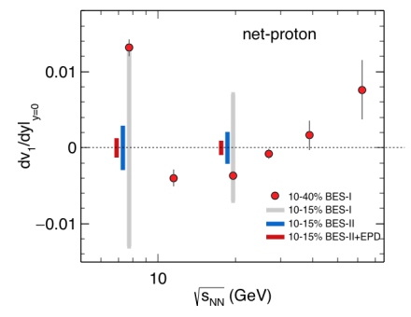
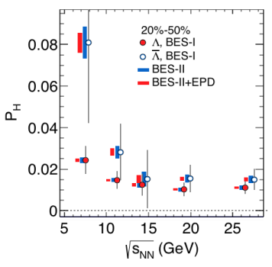
Performance and new physics
Resolution
Allowed to study
Global lambda polarisation
Significantly improved flow measurement (EP resolution)
Fluctuation studies (independent centrality determination plus increased phase space coverage)
(18.6 cm) / sqrt(2)c ≈ 0.44 ns

Slide 28
Forward Wall @ CBM ?
CBM hadron setup with replaced PSD by FWALL
First shots in simulations
Idea: combine FWALL of HADES (scintillator tilts)
EPD of STAR read-out with WLS and SiPM

Slide 29
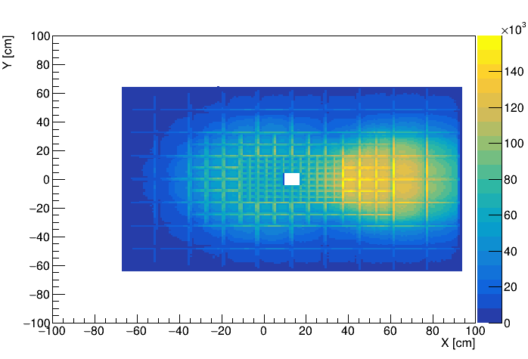
Design and transport results
Modules back side (red is air channel, gold is WLS fiber)
FWall design
FWall points XY distribution
after running UrQMD Au+Au @ 6AGeV
FWALL size is 160 cm x 128 cm x 10 cm FWALL contains 220 modules One quadrant: Number of SMALL modules: 6 x 4 – 4 (hole) Number of MEDIUM modules: 3 x 2 Number of LARGE modules: 2 x 2 Small: 4x4 cm² Medium: 8x8 cm² Large: 16x16 cm²

Slide 30
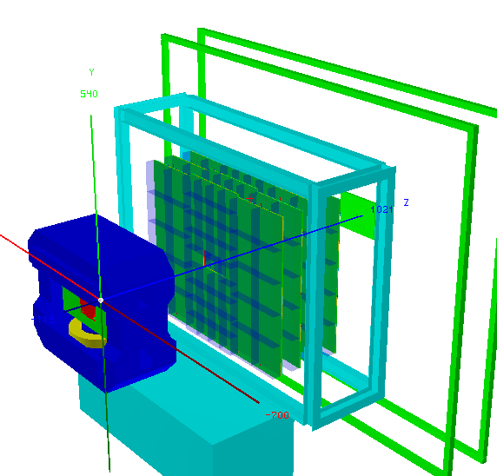
SUMMARY
Introduction into centrality and event plane determination
Examples of working detectors at other experiment
First look at simulations for new FWALL

Slide 31
THANK YOU for your attention !!

