Slide 1
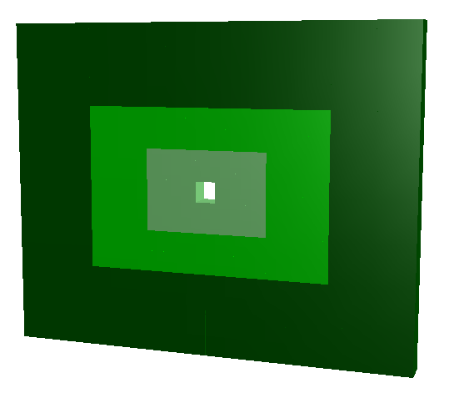
STAR Event Plane Detector (EPD)
New forward detector-status and plans
Petr Chaloupka
for the „FWAL“ group

Slide 2
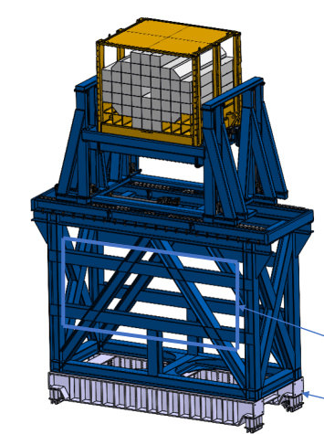
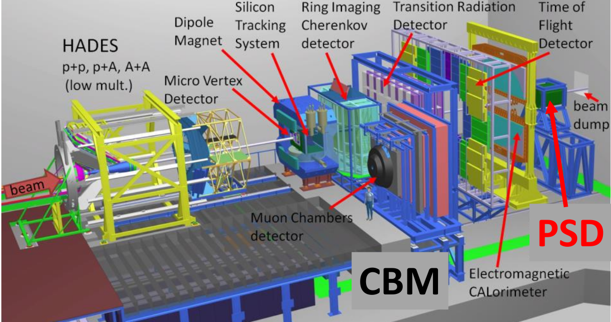
Proton Spectator Detector(PSD)

Slide 3
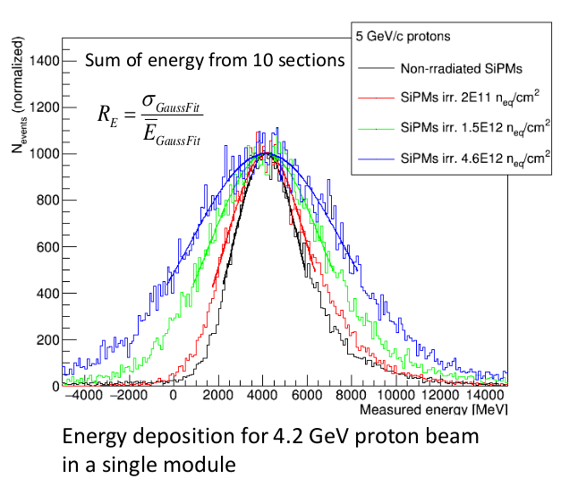
PSD radiation conditions
Petr Chaloupka
For the detector group
Andrej Kugler (NPI Řež),
Lukáš Chlad((NPI Řež, CTU Prague),
Petr Chudoba (CTU Prague)

Slide 4
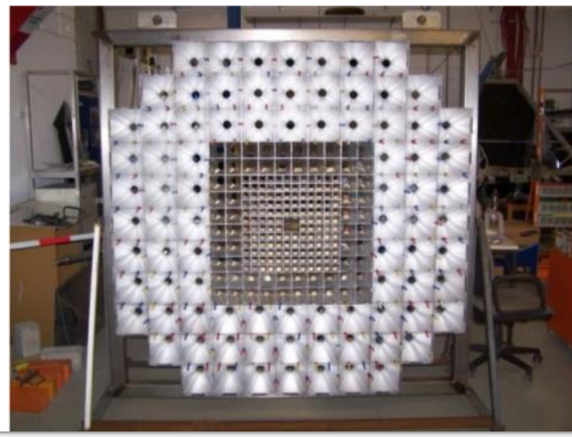
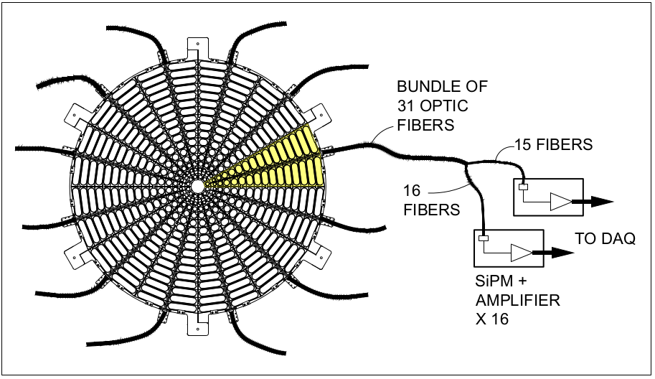
New forward detector
Proposing SCINTILLATOR HODOSCOPE:
analogous in function to HADES forward wall
Increasing granularity closer to the beam
Total charge used to determine centrality.
Fast readout by PMT – expensive
Plan to use SiPM instead
Considering similar technology as STAR EPD
Readout by embedded wavelength shifter coupled to clear fibers
SiPM readout away from radiation zone
GOALS:
fast readout, radiation hardiness
based on proven technology, reuse maxim knowledge gained from PSD
reasonable budge
NIM A 00 (2020) 1–17
Notes:
The new EPD covers the pseudo-rapidity range between 2.1 and 5.1and replaces the Beam Beam Counter(BBC) .The EPD was fully installed and became operational for the run year 2018, replacingthe Beam-Beam Counter (BBC) as a minimum-bias trigger detector
EPD allows one to carryout forward measurements of both centrality and event plane determination reducing system-atic uncertainty due to autocorrelations for midrapidity analysis. This new detector consistsof two disks that are placed on both sides of the STAR detector. EPD has pseudorapidityacceptance of 2.1< |η| <5.1 with 16 radial segments and 24 azimuthal segments nd a total of 744 channels.
Additionally, the magnetic field of 0.5 T bending the measured charged particles doesnot significantly affect the resulted event plane. Hence, all needed to be recorded bythe EPD is a single hit point of each particle
ing-weightingThis method considers different weights for each ring or ring-groups (RGs) ofEPD. [75]
v1results require forward instrumentation to measure the first order event plane.For 7.7−39GeVthis analysis is performed using the BBC, while at 62.4GeVand200GeVthe ZDC is used.
The statisticalerror here scales as 1/(R1∗√N), whereR1is the first order event plane resolution
However it should be noted that the effectiveηcoverage of the EPD is significantlydifferent for fixed-target events than for collider events
The single beam rapidities will range fromy= 5.5 for the highest energiesproposed, toy= 2.1 for the lowest energies. This indicates that the EPD will coverthe projectile fragmentation regime, which means that its role will be similar the roleplayed by the ZDC in 200 GeV Au+Au collisions.
here is a significant difference (∼20%) in the EP resolution between the EPDdetector layout with 6 and 12 azimuthal segments, whereas more than 12 azimuthalsegments do not contribute much more to the EP resolution

Slide 5
Current status:
- group structure and management
Group started in November
Weekly meetings since December
Institutes and persons involved
Czech Technical University
Petr Chaloupka
Petr Chudoba – readout electronics
Radim Dvorak (starting Ph.D.) - response sim.
Ondrej Hofman (Msc.) – FLUKA backround studies
Kristyna Haismanova (Bc.) – SiPM testing
NPI, Řež
Andrej Kugler
Leszek Kosarzewski
GSI / University of Tubingen
– physics performance studies
Ilya Selyuzhenkov
Lukáš Chlad
Oleksii Lubynets
Frédéric Linz
Notes:
The new EPD covers the pseudo-rapidity range between 2.1 and 5.1and replaces the Beam Beam Counter(BBC) .The EPD was fully installed and became operational for the run year 2018, replacingthe Beam-Beam Counter (BBC) as a minimum-bias trigger detector
EPD allows one to carryout forward measurements of both centrality and event plane determination reducing system-atic uncertainty due to autocorrelations for midrapidity analysis. This new detector consistsof two disks that are placed on both sides of the STAR detector. EPD has pseudorapidityacceptance of 2.1< |η| <5.1 with 16 radial segments and 24 azimuthal segments nd a total of 744 channels.
Additionally, the magnetic field of 0.5 T bending the measured charged particles doesnot significantly affect the resulted event plane. Hence, all needed to be recorded bythe EPD is a single hit point of each particle
ing-weightingThis method considers different weights for each ring or ring-groups (RGs) ofEPD. [75]
v1results require forward instrumentation to measure the first order event plane.For 7.7−39GeVthis analysis is performed using the BBC, while at 62.4GeVand200GeVthe ZDC is used.
The statisticalerror here scales as 1/(R1∗√N), whereR1is the first order event plane resolution
However it should be noted that the effectiveηcoverage of the EPD is significantlydifferent for fixed-target events than for collider events
The single beam rapidities will range fromy= 5.5 for the highest energiesproposed, toy= 2.1 for the lowest energies. This indicates that the EPD will coverthe projectile fragmentation regime, which means that its role will be similar the roleplayed by the ZDC in 200 GeV Au+Au collisions.
here is a significant difference (∼20%) in the EP resolution between the EPDdetector layout with 6 and 12 azimuthal segments, whereas more than 12 azimuthalsegments do not contribute much more to the EP resolution

Slide 6
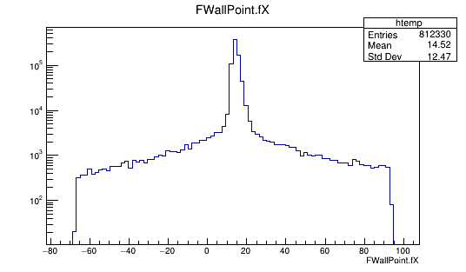
Physics performance studies
„FWall“ for
Crucial for many decision to be made
Relying heavily on PDS experience (Ilya and his group)
L. Chlad, O. Lubynets – software integration and physics performance studies
Key questions:
Granularity
effect of central hole
Influence of background
Current status:
Building on PSD code
Flexible parametrization with high granularity
Integrated into CBM-ROOT (private version)
- All steps: sim, transport, digi, reco, analysis tree
Estimated time line
Need to decide on pad sizes and geometry
End of 2023
„FWall“ for CBM
Detector size (cm):
160 x 128 x 10
Modules:
Small: 4x4 cm² Medium: 8x8 cm² Large: 16x16 cm²

Slide 7
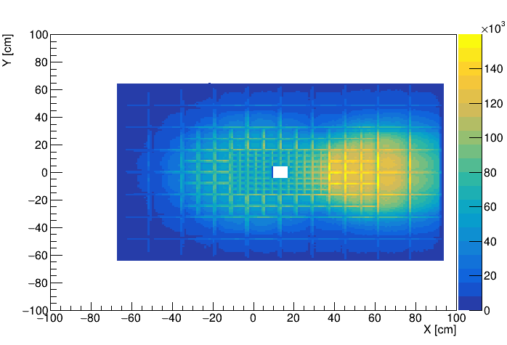
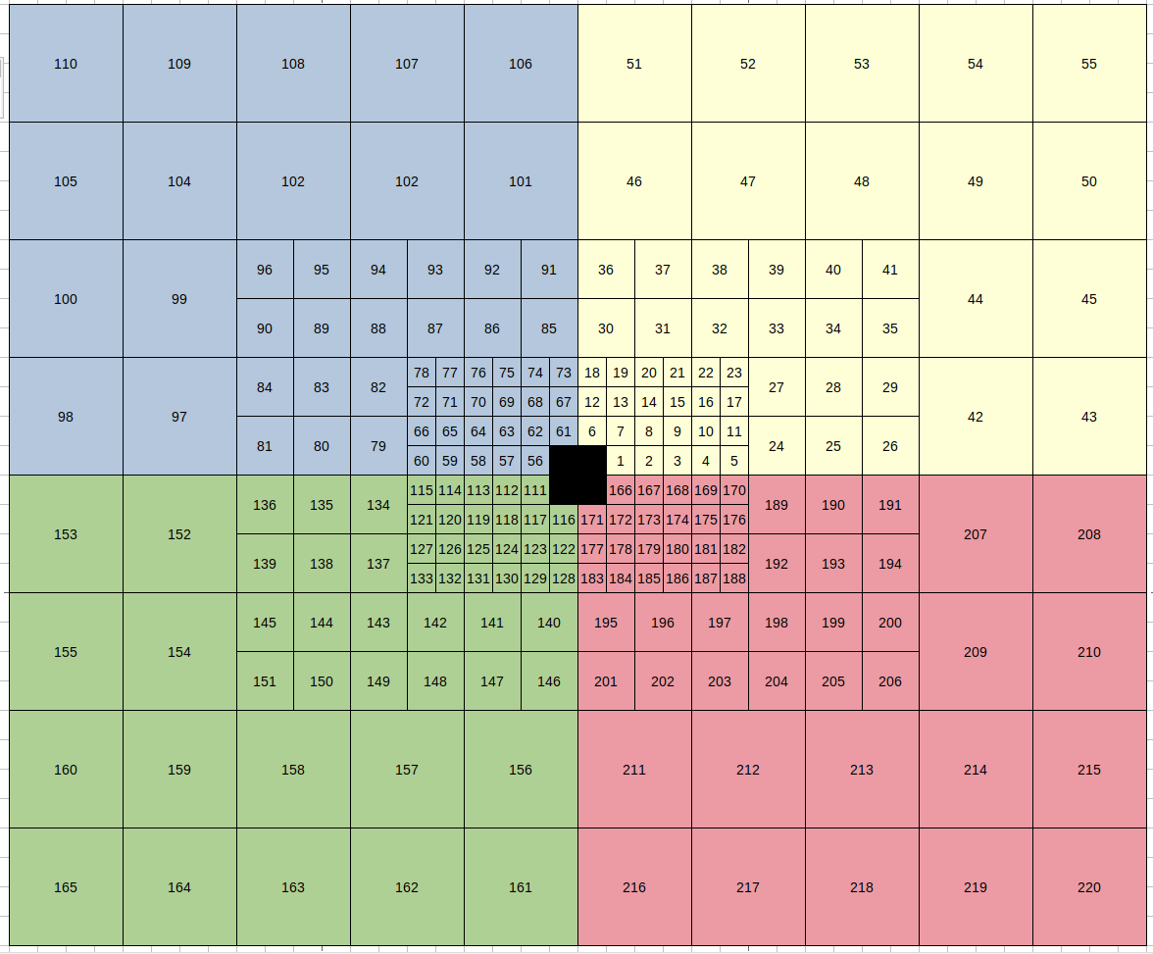
Detector modules
Individual scintillator „pads“
~ 300 pieces
Varying sizes (4 – 16 cm wide, 5cm thick)
Much depends on expected radiation dose
Material choice:
plastic ZnS scintillator
- not rad. hard, cheap replaceable
LYSO crystal ( offered from Juelich )
- central part, possible to anneal
Readout with SiPM(considered variants)
Direct coupling (CALICE style)
Wave guide + direct coupling
WLS+clear fiber (EPD style)
Detector size (cm):
160 x 128 x 10
Modules:
Small: 4x4 cm² Medium: 8x8 cm² Large: 16x16 cm²
UrQMD Au+Au @ 6AGeV

Slide 8
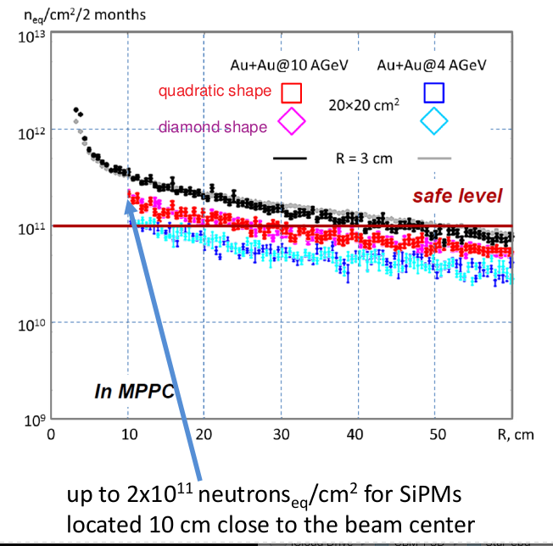
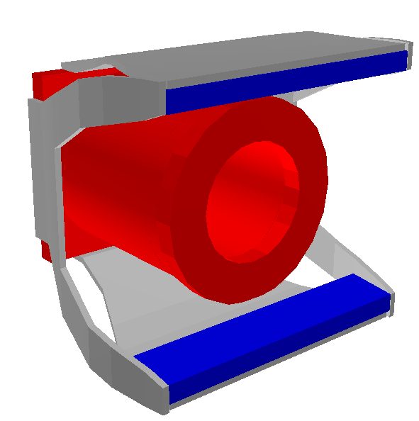
Expected dose
Much depends on expected radiation dose
For PSD done with MCNP
Started FLUKA simulations (O Hofman, A. Senger)
First results expected within month
Available realistic model of beam pipe and below - lot of material so far
Lessons from PSD radiation hardiness tests:
Energy resolution dropped in about 1.5 – 2 for SiPMs irradiated by ~10¹² n_{eq} /cm².
Introduction of larger beam hole

Slide 9
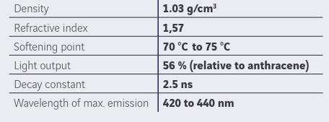
Detector modules-material
www.nuviatech-instruments.com,
Material choice:
Plastic + ZnS scintillator
- not rad. hard, cheap replaceable
LYSO crystal ( offered from Juelich )
- central part, possible to anneal
Local producer Nuvia ( part of Saint-Gobain)
Custom tuning of scintillator properties
Mechanical and optical processing
- time vs money
WLS embedding (Y-11)
- Kuraray factory closed for now
Now preparing first test sample
- quick progress towards mCBM
Cooperation in radiation hardness tests
- effects of heavy fragments and high ionisation density
Supplier MCORD (Modular Cosmic Ray Detector detector) for MPD

Slide 10
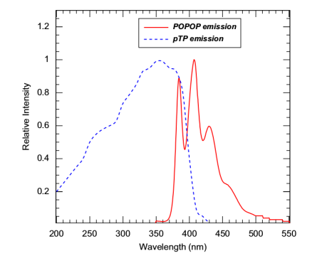
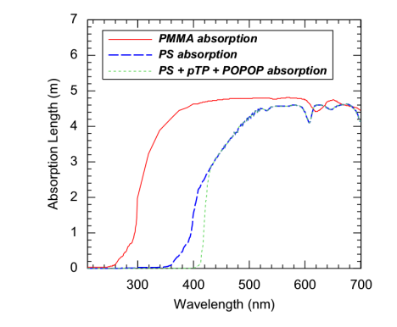
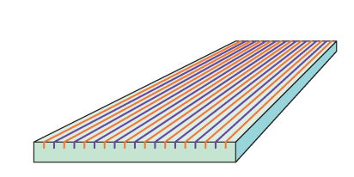
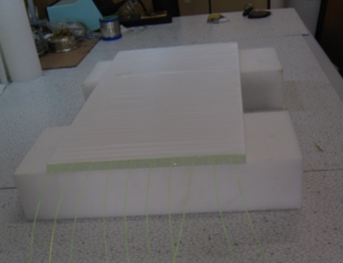
Detector modules-material
Module response – questions
Light yield
- Effect of high ionization density
- dE/dx resolution
Time resolution and signal width
Effect of surface quality and WLS geometry
Need of response simulator
- Geant 3 vs 4
- Physics list and material properties
Same material with Y-11 in grooves was used for S³ experiment
Tuned Geant 4 simulation code available (R. Dvorak)
Material properties tuned in cooperation with manufacturer
Lukáš Fajt:
Prototype of detector for detection of reactor’s antineutrinos

Slide 11
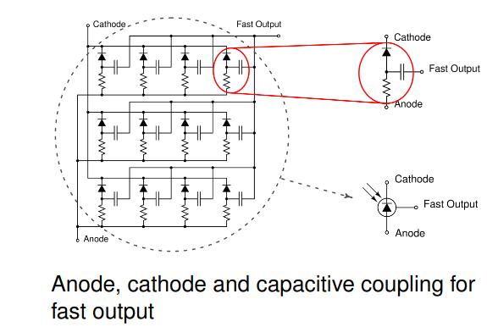
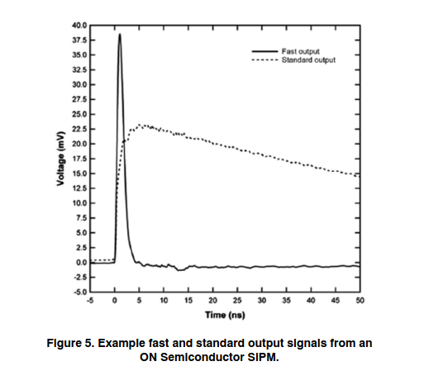
SiPM testing
The chosen solution will depend on expected radiation doses and rad. hardness test
Readout with SiPM
Direct coupling w. or w.out wave guide
WLS+clear fiber (EPD style)
SiPM considered
Hamamatsu – tested for PSD
ON Semiconductor
- fast output channel
- possible pile up detection
- needs testing
Already procured test sample
Takes long .. :-(
Common interest with local eRHIC group
Started testing
Rise time: 300 ps − 1 ns
pulse widths: 600 ps − 3 ns FWHM

Slide 12
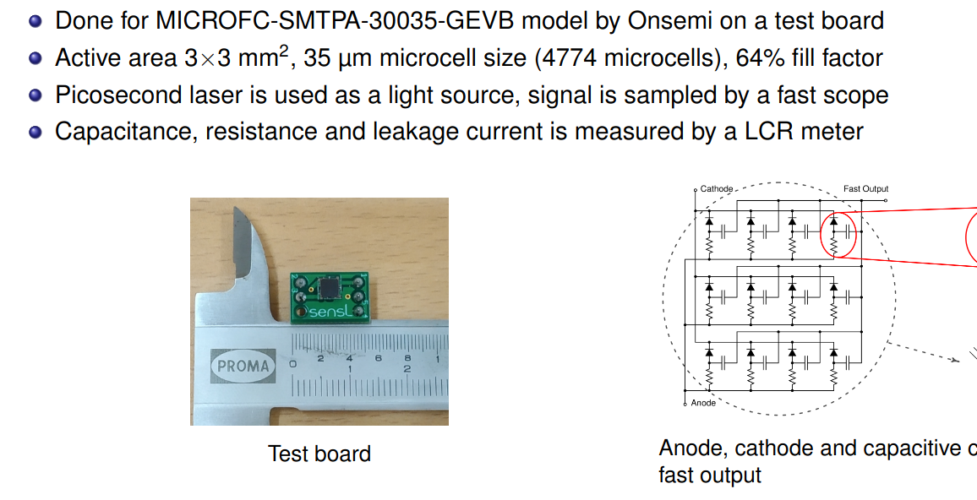
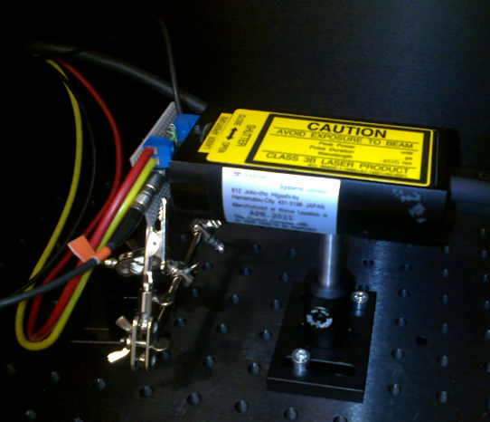
Onsemi SiPM characteristics
Testing setup ready at CTU
Work and slides: J. Adam, CTU

Slide 13
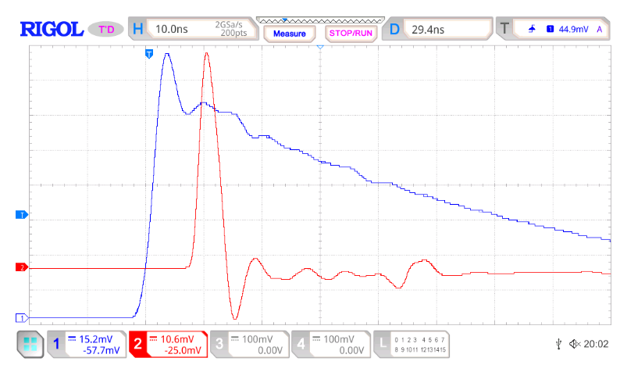
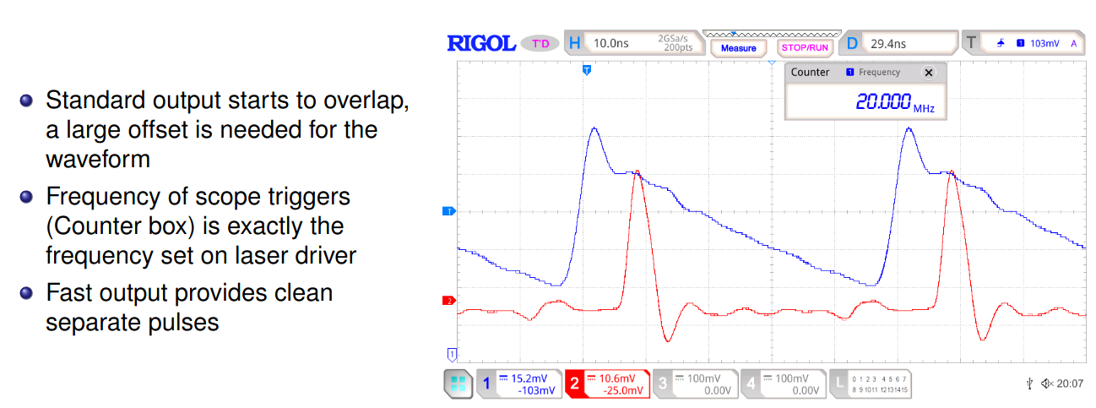
Onsemi SiPM characteristics
Signal shape
Work and slides: J. Adam, CTU

Slide 14
Onsemi SiPM characteristics
Work and slides: J. Adam, CTU

Slide 15
Onsemi SiPM characteristics
Work and slides: J. Adam, CTU
Characterization of Onsemi SiPM
Bc. student (K. Haismanova)
Measuring characteristic of multiple SiPM
- capacitance (as function of dose)
- noise and after pulses
Plan to test temperature sensitivity
- cooperation with CALICE
Irradiation tests at Rez
- similar to previous tests of Hamamatsu for PSD
Timeline
One year + for final decision
May depend development of electronics
Likely after mCBM test

Slide 16
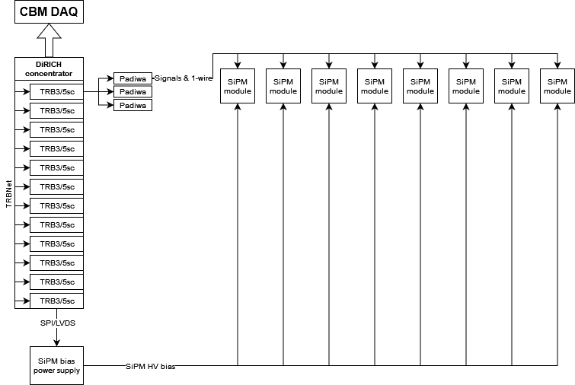
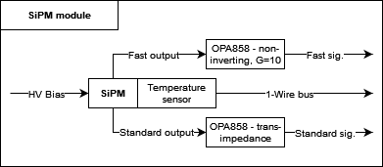
Readout electronics concept
Aiming to use available solutions ( developed by P. Chudoba)
Readout electronics to be build up on the TRB3/5sc in crate using DiRICH concentrator in order to reuse RICH implementation to CBM DAQ
- custom backplane for TRBs needs to be developed
Both signals from SiPM to be amplified using OP858 op. amp – to be able to transport signals via 50Ω cables to padiwas
Realtime measurement of the SiPM temperature and subsequent corrections to bias voltage (CALICE solution)
Test setup available at CTU
- aiming for mCBM installation
- Fast output – non-inverting amplification
- Standard output – trans-impedance amplification
Constant measurement of the SiPM temperature and subsequent corrections to bias voltage
Test setup available at CTU

Slide 17
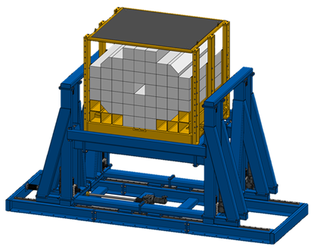
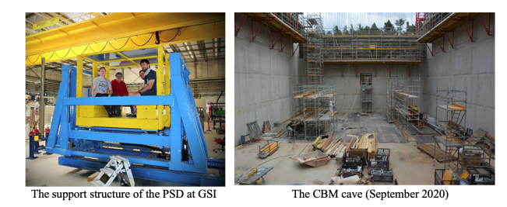
Other things
Did not do any studies yet….
Mechanical design
Reusing PSD platform
Can support „any“ weight
- Can have robust frame if needed
Will it be possible to hang on the front?
- Would still be able to add calorimeter in future
Likely build by the same CTU group from the Faculty of Mechanical Engineering
Calibration
Based on on LED-pulser
Ideally brought to both scintillators and SiPMs
May use existing solution for LED pulser from CALICE
Physics Procedia 37 (2012) 402 – 409
Notes:
Centrality resolution for collision energies s N N
= 19.6, 14.5, 11.5, and 7.7 GeV. The observables based on
mid-rapidity multiplicity are X RM 1 (green closed circles) and
X RM 3 (dark green open circles). The observables based on
unweighted distributions from the forward region are X F W D
(blue open square) for particle yield and X ζ 0 (blue open tri-
angle) for truncated energy loss in the EPD. The observables
based on linear weights are X W,F W D (closed dark red square)
and X W,ζ 0 (closed red triangle).

Slide 18
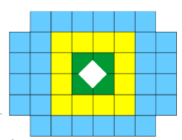
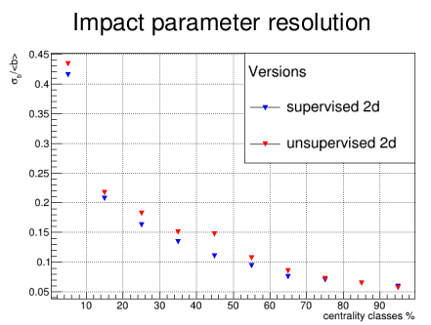
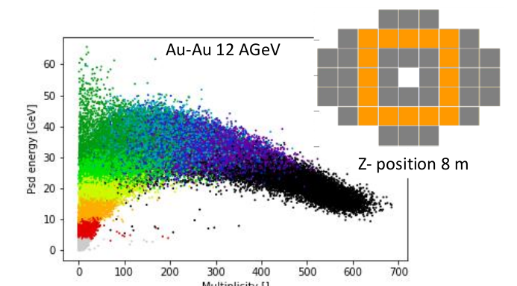
Centrality determination
DCM-QGSM-SMM, Au-Au @ 12A GeV/c
D.Finogeev at 38th CBM Collaboration Meeting

Slide 19
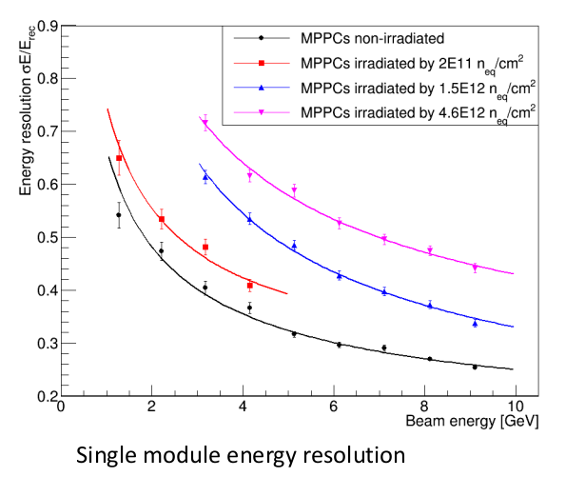
PSD radiation conditions
Radiation hardiness tests:
total decrease in light yield ~ 40 % can be expected after 10 kGy (max. dose for 10 years of operation)
Energy resolution dropped in about 1.5 – 2 for SiPMs irradiated by ~10¹² n_{eq} /cm².
Introduction of larger beam hole
V. Mikhaylov, SiPM (APD) radiation hardness for PSD CBM, Meeting of SAC for FAIR-CZ, Prague 12.2.2020

Slide 20
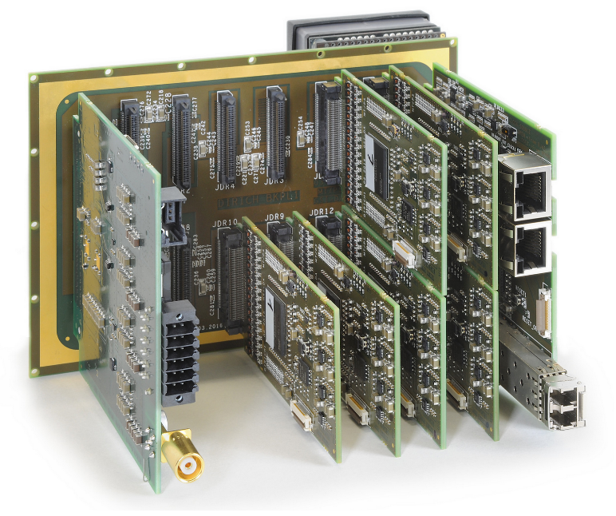
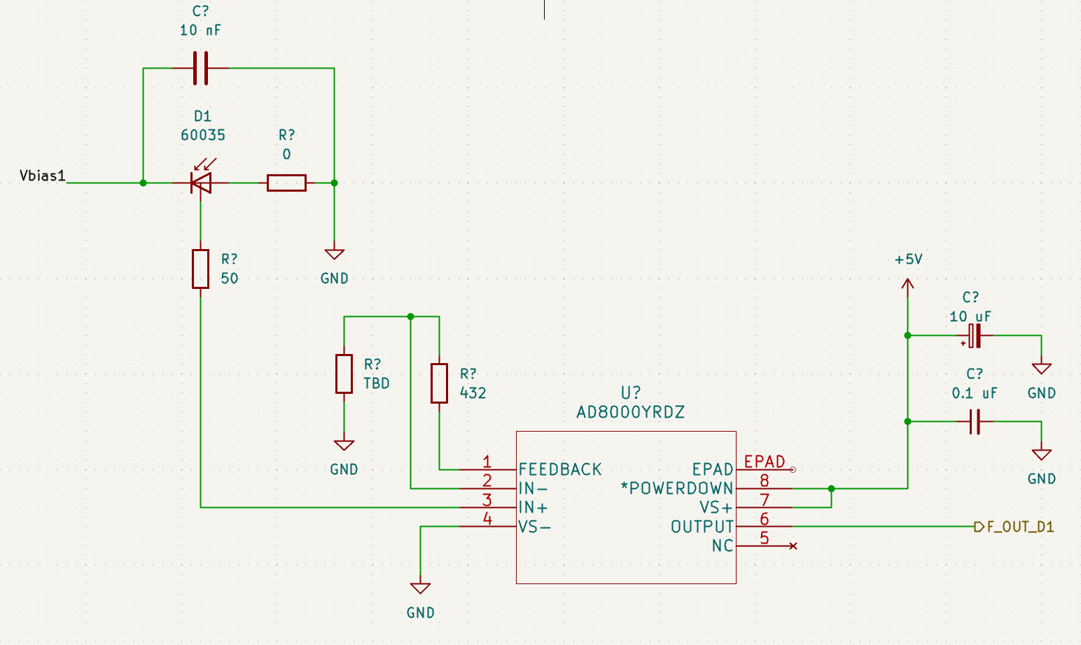
Read-out electronics
In order to minimize the development and implementation effort and time in CBM very well known DiRICH electronics was chosen.
Instead of the MAPMT, SiPMs are planned to be used
Assembly of several boards will be used to mimic the MAPMT interface
Carrier board
transfers signals to DiRICH backplane
holds SiPM blades and perhaps voltage control modules
SiPM blade
16 SiPMs
temperature sensing
signal amplification/shaping
Bias voltage control - TBD
Signal amplification
First ideas are drawn and to be evaluated
Notes:
Centrality resolution for collision energies s N N
= 19.6, 14.5, 11.5, and 7.7 GeV. The observables based on
mid-rapidity multiplicity are X RM 1 (green closed circles) and
X RM 3 (dark green open circles). The observables based on
unweighted distributions from the forward region are X F W D
(blue open square) for particle yield and X ζ 0 (blue open tri-
angle) for truncated energy loss in the EPD. The observables
based on linear weights are X W,F W D (closed dark red square)
and X W,ζ 0 (closed red triangle).

Slide 21
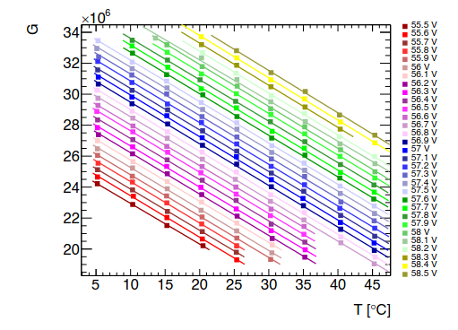
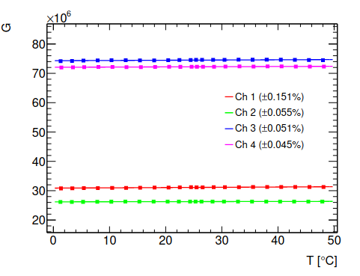
Choice of SiPMs
S forward wall
Things to consider:
Radiation hardness – not crutial
All balanced against cross talk, gain, noise …
Overvoltage control and temperature stabilization
Temperature monitoring on blade boards
Temperature-controled readout box
Possibly adaptive bias voltage regulator
discussing with CALICE experts
Hamamatsu MPPC S13360-1325b
G. Eigen et al 2019 JINST 14 P05006
Odkud tehle obrazek mam?
Notes:
Centrality resolution for collision energies s N N
= 19.6, 14.5, 11.5, and 7.7 GeV. The observables based on
mid-rapidity multiplicity are X RM 1 (green closed circles) and
X RM 3 (dark green open circles). The observables based on
unweighted distributions from the forward region are X F W D
(blue open square) for particle yield and X ζ 0 (blue open tri-
angle) for truncated energy loss in the EPD. The observables
based on linear weights are X W,F W D (closed dark red square)
and X W,ζ 0 (closed red triangle).

Slide 22
Choice of SiPMs
S forward wall
Things to consider:
Radiation hardness – not crutial
All balanced against cross talk, gain, noise …
Overvoltage control and temperature stabilization
Temperature monitoring on readout boards
Temperature-controled readout box
Possibly adaptive bias voltage regulator
discussing with CALICE experts
Calibration
Based on on LED-pulser
Ideally brought to both scintillators and SiPMs
Physics Procedia 37 (2012) 402 – 409
Odkud tehle obrazek mam?
Notes:
Centrality resolution for collision energies s N N
= 19.6, 14.5, 11.5, and 7.7 GeV. The observables based on
mid-rapidity multiplicity are X RM 1 (green closed circles) and
X RM 3 (dark green open circles). The observables based on
unweighted distributions from the forward region are X F W D
(blue open square) for particle yield and X ζ 0 (blue open tri-
angle) for truncated energy loss in the EPD. The observables
based on linear weights are X W,F W D (closed dark red square)
and X W,ζ 0 (closed red triangle).

Slide 23
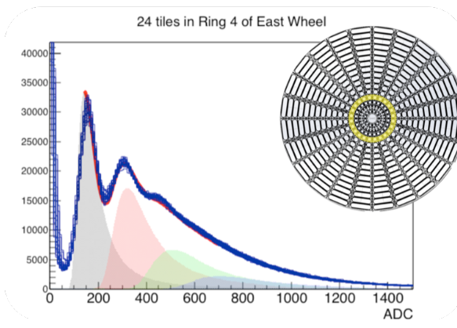
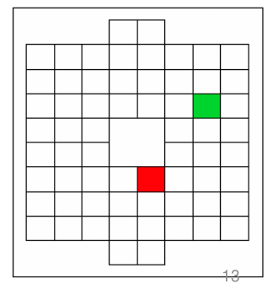
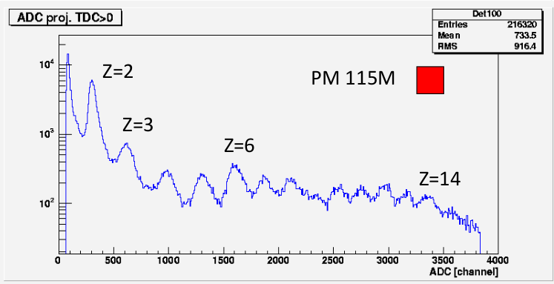
Choice of SiPMs
S forward wall
Things to consider:
Radiation hardness – not crutial
All balanced against cross talk, gain, noise …
Overvoltage control and temperature stabilization
Temperature monitoring on readout boards
Temperature-controled readout box
Possibly adaptive bias voltage regulator
discussing with CALICE experts
Calibration
Based on on LED-pulser
Ideally brought to both scintillator and SiPMs
Dynamic range
High charge fragments
Possible non-linearity and saturation
Will need simulation
May add attenuated readout channel
Odkud tehle obrazek mam?
Notes:
Centrality resolution for collision energies s N N
= 19.6, 14.5, 11.5, and 7.7 GeV. The observables based on
mid-rapidity multiplicity are X RM 1 (green closed circles) and
X RM 3 (dark green open circles). The observables based on
unweighted distributions from the forward region are X F W D
(blue open square) for particle yield and X ζ 0 (blue open tri-
angle) for truncated energy loss in the EPD. The observables
based on linear weights are X W,F W D (closed dark red square)
and X W,ζ 0 (closed red triangle).

Slide 24
Choice of SiPMs
S forward wall
Things to consider:
Radiation hardness – not crutial
All balanced against cross talk, gain, noise …
Overvoltage control and temperature stabilization
Temperature monitoring on readout boards
Temperature-controled readout box
Possibly adaptive bias voltage regulator
discussing with CALICE experts
Calibration
Based on on LED-pulser
Ideally brought to both scintillator and SiPMs
Dynamic range
High charge fragments
Possible non-linearity and saturation
Will need simulation
May add attenuated readout channel
Time resolution
Likely driven by tile size and WLS
Considering Onsemi SiPM with fast output
Rise time 300 ps − 1 ns and pulse widths of 600 ps − 3 ns FWHM
Notes:
Centrality resolution for collision energies s N N
= 19.6, 14.5, 11.5, and 7.7 GeV. The observables based on
mid-rapidity multiplicity are X RM 1 (green closed circles) and
X RM 3 (dark green open circles). The observables based on
unweighted distributions from the forward region are X F W D
(blue open square) for particle yield and X ζ 0 (blue open tri-
angle) for truncated energy loss in the EPD. The observables
based on linear weights are X W,F W D (closed dark red square)
and X W,ζ 0 (closed red triangle).

Slide 25
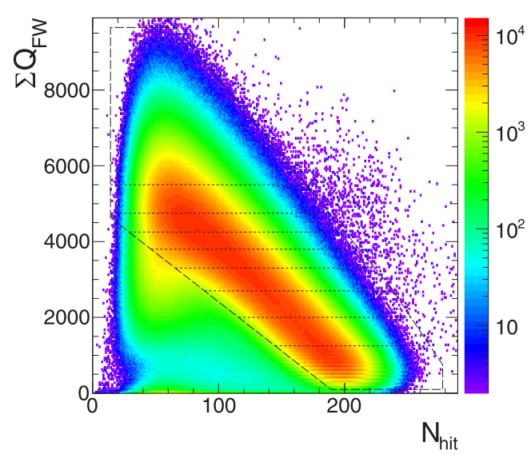
Simulation for physics perfomance
Many questions:
Event plane and centrality resolution
Background effcest
Effect of central hole
Optimization of tile depth
Influence on charge-weighting
Yield vs readout time
Needed dynamics range
Expected radiation dose (FLUKA)
Previously done with MCNP
How close can we get to beam?
S forward wall
PSD radiatiion dose simulation
HADES FWall
DCM-QGSM-SMM, Au-Au @ 12A GeV/c
D.Finogeev at 38th CBM Collaboration Meeting
PRC 102, 024914
Notes:
Centrality resolution for collision energies s N N
= 19.6, 14.5, 11.5, and 7.7 GeV. The observables based on
mid-rapidity multiplicity are X RM 1 (green closed circles) and
X RM 3 (dark green open circles). The observables based on
unweighted distributions from the forward region are X F W D
(blue open square) for particle yield and X ζ 0 (blue open tri-
angle) for truncated energy loss in the EPD. The observables
based on linear weights are X W,F W D (closed dark red square)
and X W,ζ 0 (closed red triangle).

Slide 26
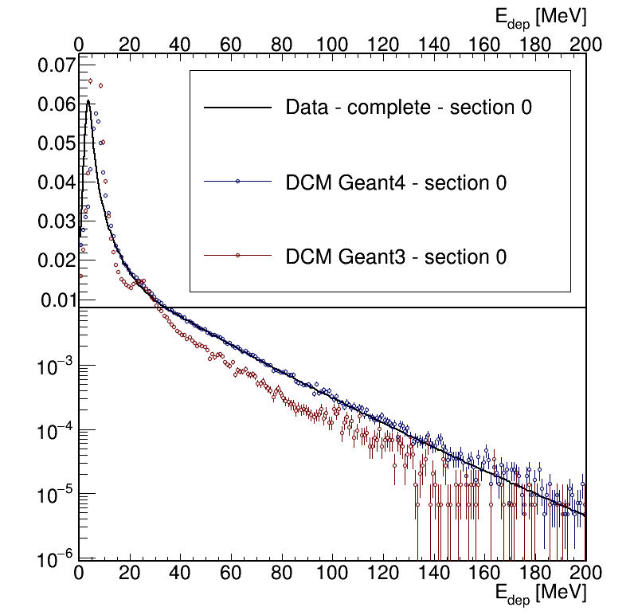
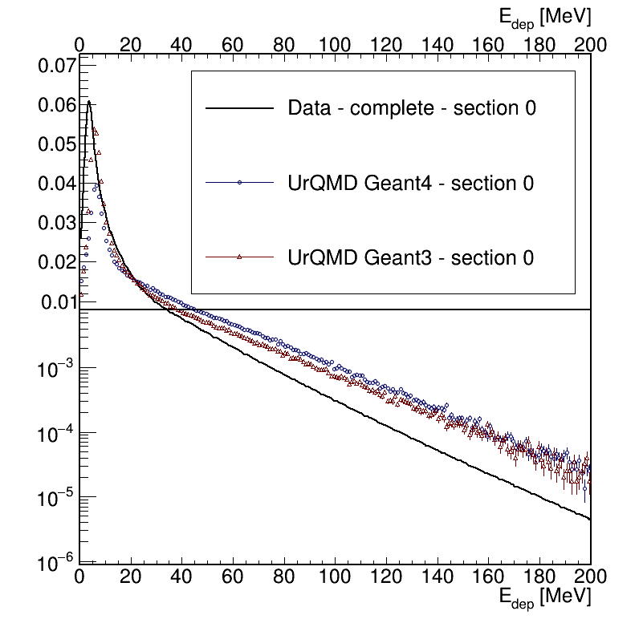
Simulation for physics perfomance
S forward wall
„FWall“ for CBM
Very first look (Lukas Chlad):
Geometry taken from HADES
uRQMD
Will try fine grained model and resuming
Planning to use other models
Geant4 + DCM-QGSM seemed to do better for PSD
Plan to use QnVector framework and compare to PSD performance simulations
„FWall“ for CBM
Detector size (cm):
160 x 128 x 10
Modules:
Small: 4x4 cm² Medium: 8x8 cm² Large: 16x16 cm²
Comparison of PSD simulation with mCBM real data (L. Chlad):
UrQMD Au+Au @ 6AGeV
Notes:
Centrality resolution for collision energies s N N
= 19.6, 14.5, 11.5, and 7.7 GeV. The observables based on
mid-rapidity multiplicity are X RM 1 (green closed circles) and
X RM 3 (dark green open circles). The observables based on
unweighted distributions from the forward region are X F W D
(blue open square) for particle yield and X ζ 0 (blue open tri-
angle) for truncated energy loss in the EPD. The observables
based on linear weights are X W,F W D (closed dark red square)
and X W,ζ 0 (closed red triangle).

Slide 27
Plans
Work started on the main areas
Software and physics performance
Detector geometry and granularity by the end of 2023
Hardware
Module design and testing of components
- final decision on SiPM, scintillation and readout type by the end of 2024
Electronics design
- pushing for early version for mCBM setup
- will need review at some point
- finalize by end of 2025
Short term plan:
Modules for testing
mCBM setup for electronics and module response test
Need to make long term plan (with help of Piotr)
Not unreasonable to aim for end of 2026 (reserve for procurement and testing)
Need to thing about risks (delays, procurement,..?)
Notes:
Centrality resolution for collision energies s N N
= 19.6, 14.5, 11.5, and 7.7 GeV. The observables based on
mid-rapidity multiplicity are X RM 1 (green closed circles) and
X RM 3 (dark green open circles). The observables based on
unweighted distributions from the forward region are X F W D
(blue open square) for particle yield and X ζ 0 (blue open tri-
angle) for truncated energy loss in the EPD. The observables
based on linear weights are X W,F W D (closed dark red square)
and X W,ζ 0 (closed red triangle).

Slide 28
Budget and man power
Czech side:
Manpower
Longterm support from Ministry of Education program of “Large infrastructures”
Mainly man power – one FTE for CBM
- Support of current team
Will try to get additional post doc
Hardware
Upcoming call for hardware money
First estimate ~250k EUR
- depend on mainly number of channel
- currently asking for pricing
Risk
Dwindling support of science in Czech Rep.
- increasing public debt after Covid
- increasing price of energy and service
Notes:
Centrality resolution for collision energies s N N
= 19.6, 14.5, 11.5, and 7.7 GeV. The observables based on
mid-rapidity multiplicity are X RM 1 (green closed circles) and
X RM 3 (dark green open circles). The observables based on
unweighted distributions from the forward region are X F W D
(blue open square) for particle yield and X ζ 0 (blue open tri-
angle) for truncated energy loss in the EPD. The observables
based on linear weights are X W,F W D (closed dark red square)
and X W,ζ 0 (closed red triangle).

Slide 29
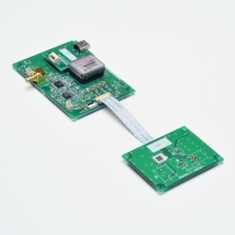
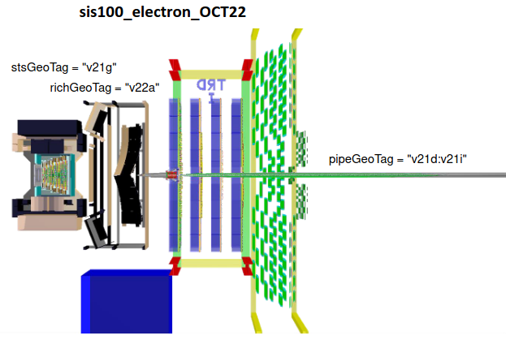
Where are we now
Testing setup TRB+DiRich+SiPM test board
(thanks to Michael Traxler)
Designing add-on board for DiRich backplane
Voltage regulation
Temperature measurement
Initial ideas on calibrations and mechanical design
...those will likely change many times
Starting work on simulations
Initial work with uRQMD
Needs realistic backround + material (beampipe)
Planning to use QnVector Corrections and Analysis framework
Many things not addressed yet
mainly scintilllator and WLS material
Other things
Make small setup for testing at mCBM
Opportunistic complementation with calorimeter modules
Involve other interested institutions/persons
Notes:
Centrality resolution for collision energies s N N
= 19.6, 14.5, 11.5, and 7.7 GeV. The observables based on
mid-rapidity multiplicity are X RM 1 (green closed circles) and
X RM 3 (dark green open circles). The observables based on
unweighted distributions from the forward region are X F W D
(blue open square) for particle yield and X ζ 0 (blue open tri-
angle) for truncated energy loss in the EPD. The observables
based on linear weights are X W,F W D (closed dark red square)
and X W,ζ 0 (closed red triangle).

Slide 30
Plans and budget
We have ideas and started to work on the main topics
Software and physics performance
Initial ideas on calibrations and mechanical design
...those will likely change many times
Starting work on simulations
Initial work with uRQMD
Needs realistic backround + material (beampipe)
Planning to use QnVector Corrections and Analysis framework
Many things not addressed yet
mainly scintilllator and WLS material
Other things
Make small setup for testing at mCBM
Opportunistic complementation with calorimeter modules
Involve other interested institutions/persons
Notes:
Centrality resolution for collision energies s N N
= 19.6, 14.5, 11.5, and 7.7 GeV. The observables based on
mid-rapidity multiplicity are X RM 1 (green closed circles) and
X RM 3 (dark green open circles). The observables based on
unweighted distributions from the forward region are X F W D
(blue open square) for particle yield and X ζ 0 (blue open tri-
angle) for truncated energy loss in the EPD. The observables
based on linear weights are X W,F W D (closed dark red square)
and X W,ζ 0 (closed red triangle).

Slide 31
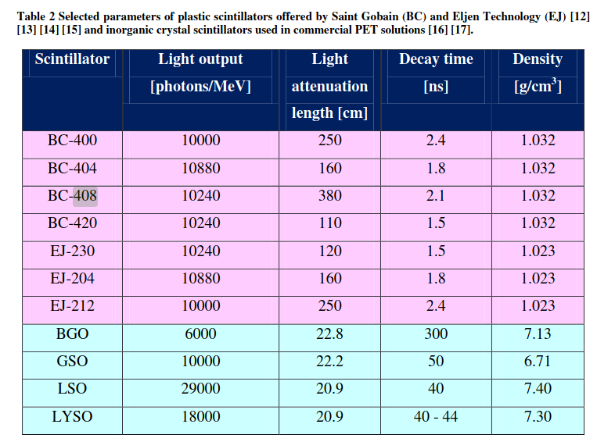
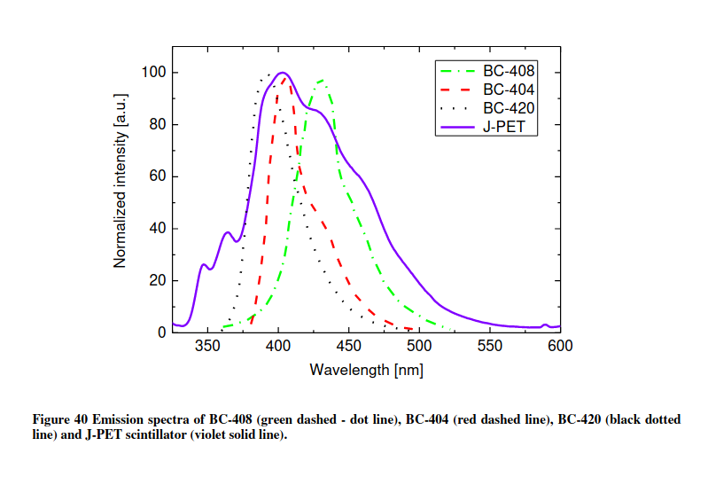
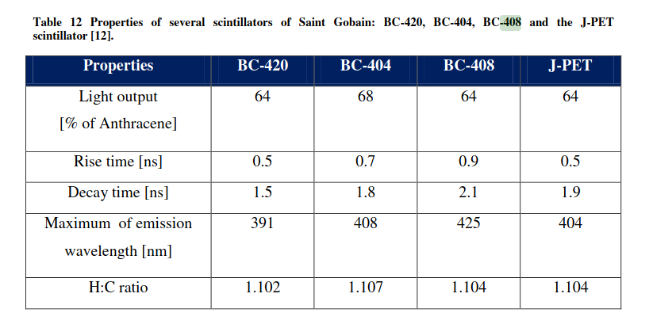
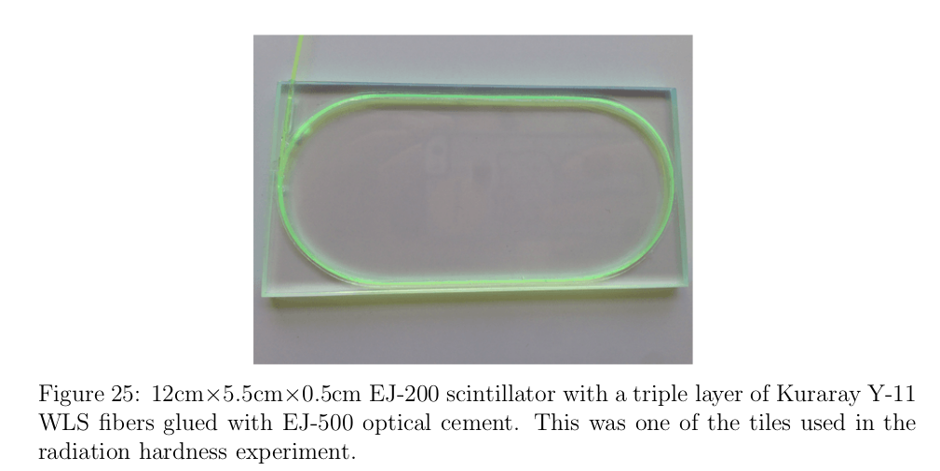
best matching to the quantum efficiency wavelength dependency of silicon photomultipliers is achieved for BC-408 scintillator

Slide 32
New forward detector for CBM
HADES forward wall
GOALS:
Physics - similar to PSD: event plane and centrality reconstruction
fast readout, radiation hardiness
based on proven technology, reuse maxim knowledge gained from PSD
reasonable budge
Proposing SCINTILLATOR HODOSCOPE:
analogous in function to HADES forward wall
Increasing granularity closer to the beam
Total charge used to determine centrality.
Fast readout by PMT – expensive
Plan to use SiPM instead
Notes:
The new EPD covers the pseudo-rapidity range between 2.1 and 5.1and replaces the Beam Beam Counter(BBC) .The EPD was fully installed and became operational for the run year 2018, replacingthe Beam-Beam Counter (BBC) as a minimum-bias trigger detector
EPD allows one to carryout forward measurements of both centrality and event plane determination reducing system-atic uncertainty due to autocorrelations for midrapidity analysis. This new detector consistsof two disks that are placed on both sides of the STAR detector. EPD has pseudorapidityacceptance of 2.1< |η| <5.1 with 16 radial segments and 24 azimuthal segments nd a total of 744 channels.
Additionally, the magnetic field of 0.5 T bending the measured charged particles doesnot significantly affect the resulted event plane. Hence, all needed to be recorded bythe EPD is a single hit point of each particle
ing-weightingThis method considers different weights for each ring or ring-groups (RGs) ofEPD. [75]
v1results require forward instrumentation to measure the first order event plane.For 7.7−39GeVthis analysis is performed using the BBC, while at 62.4GeVand200GeVthe ZDC is used.
The statisticalerror here scales as 1/(R1∗√N), whereR1is the first order event plane resolution
However it should be noted that the effectiveηcoverage of the EPD is significantlydifferent for fixed-target events than for collider events
The single beam rapidities will range fromy= 5.5 for the highest energiesproposed, toy= 2.1 for the lowest energies. This indicates that the EPD will coverthe projectile fragmentation regime, which means that its role will be similar the roleplayed by the ZDC in 200 GeV Au+Au collisions.
here is a significant difference (∼20%) in the EP resolution between the EPDdetector layout with 6 and 12 azimuthal segments, whereas more than 12 azimuthalsegments do not contribute much more to the EP resolution

Slide 33
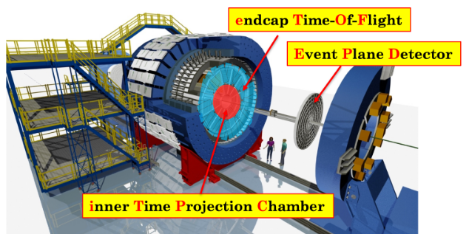
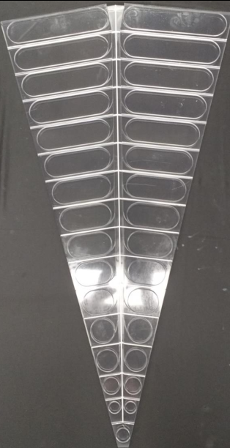
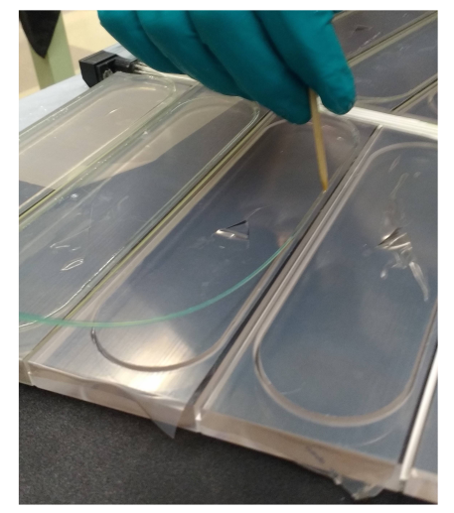
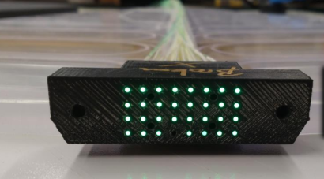
New forward detector for CBM
IHADES forward wall
Propose to use similar technology as STAR EPD
1.2cm thick plastic block divided into optically isolated segments
2.1< |η| <5.1 with 16 radial segments and 24 azimuthal segments, total of 744 channels
Readout by embedded wavelength shifter coupled to clear fibers
SiPM readout away from radiation zone
Nuclear Instrumentation and Methods A 00 (2020) 1–17
Notes:
The new EPD covers the pseudo-rapidity range between 2.1 and 5.1and replaces the Beam Beam Counter(BBC) .The EPD was fully installed and became operational for the run year 2018, replacingthe Beam-Beam Counter (BBC) as a minimum-bias trigger detector
EPD allows one to carryout forward measurements of both centrality and event plane determination reducing system-atic uncertainty due to autocorrelations for midrapidity analysis. This new detector consistsof two disks that are placed on both sides of the STAR detector. EPD has pseudorapidityacceptance of 2.1< |η| <5.1 with 16 radial segments and 24 azimuthal segments nd a total of 744 channels.
Additionally, the magnetic field of 0.5 T bending the measured charged particles doesnot significantly affect the resulted event plane. Hence, all needed to be recorded bythe EPD is a single hit point of each particle
ing-weightingThis method considers different weights for each ring or ring-groups (RGs) ofEPD. [75]
v1results require forward instrumentation to measure the first order event plane.For 7.7−39GeVthis analysis is performed using the BBC, while at 62.4GeVand200GeVthe ZDC is used.
The statisticalerror here scales as 1/(R1∗√N), whereR1is the first order event plane resolution
However it should be noted that the effectiveηcoverage of the EPD is significantlydifferent for fixed-target events than for collider events
The single beam rapidities will range fromy= 5.5 for the highest energiesproposed, toy= 2.1 for the lowest energies. This indicates that the EPD will coverthe projectile fragmentation regime, which means that its role will be similar the roleplayed by the ZDC in 200 GeV Au+Au collisions.
here is a significant difference (∼20%) in the EP resolution between the EPDdetector layout with 6 and 12 azimuthal segments, whereas more than 12 azimuthalsegments do not contribute much more to the EP resolution

Slide 34
STAR EPD
IHADES forward wall
EPD tested at STAR – installed 2018
scintillator milling and optical readout
readout optimized for MIP counting (<5 per sector)
single-tile timing resolution 0.44 ns
event plane and centrality reconstruction
Ring-weighting, MLR
comparable
Centrality resolution
Phys. Lett. B 827 (2022) 137003
Phys. Rev. C 103, 044902
Notes:
Centrality resolution for collision energies s N N
= 19.6, 14.5, 11.5, and 7.7 GeV. The observables based on
mid-rapidity multiplicity are X RM 1 (green closed circles) and
X RM 3 (dark green open circles). The observables based on
unweighted distributions from the forward region are X F W D
(blue open square) for particle yield and X ζ 0 (blue open tri-
angle) for truncated energy loss in the EPD. The observables
based on linear weights are X W,F W D (closed dark red square)
and X W,ζ 0 (closed red triangle).

Slide 35
Scinitillator hodoscope for CBM
IHADES forward wall
CHALLENGES to resolve
Read out electronics and integration to CBM
Optimize physics performance
shape and granularity
High luminosity + higher Z fragments
Sum of charges to measure event plane
Radiation damage
No information from neutrons
Effect on centrality measurement
Damage from beam halo
Effect of beam hole
Could we get closer to the beam?
Need performance studies
Build us much as possible on PSD experience
Notes:
Centrality resolution for collision energies s N N
= 19.6, 14.5, 11.5, and 7.7 GeV. The observables based on
mid-rapidity multiplicity are X RM 1 (green closed circles) and
X RM 3 (dark green open circles). The observables based on
unweighted distributions from the forward region are X F W D
(blue open square) for particle yield and X ζ 0 (blue open tri-
angle) for truncated energy loss in the EPD. The observables
based on linear weights are X W,F W D (closed dark red square)
and X W,ζ 0 (closed red triangle).

Slide 36
Scinitillator hodoscope for CBM
IHADES forward wall
CHALLENGES to resolve
Optimize shape and granularity
Effect of CBM magnetic field
Likely asymmetric design
High luminosity + higher Z fragments
Sum of charges to measure event plane
Radiation damage
No information from neutrons
Effect on centrality measurement
Damage from beam halo
Effect of beam hole
Could we get closer to the beam?
Read out electronics
Need performance studies
Build us much as possible on PSD experience
Notes:
Centrality resolution for collision energies s N N
= 19.6, 14.5, 11.5, and 7.7 GeV. The observables based on
mid-rapidity multiplicity are X RM 1 (green closed circles) and
X RM 3 (dark green open circles). The observables based on
unweighted distributions from the forward region are X F W D
(blue open square) for particle yield and X ζ 0 (blue open tri-
angle) for truncated energy loss in the EPD. The observables
based on linear weights are X W,F W D (closed dark red square)
and X W,ζ 0 (closed red triangle).

Slide 37
Involvement in project
ICTU Prague, CZE
Performance studies, detector manufacturing
Previous experience with ALICE FDD
Mechanical design at faculty of mechanical eng.
NPI Řež, CZE
experience with HADES fwd wall and TOF
Detector manufacturing ,assembly and testing
As done for PDS
National Center for Nuclear Research, Poland
Readout electronics
Experience from MCORD (Modular Cosmic Ray Detector detector) for MPD
Similar readout techniques
Full readout system

Slide 38
Tohle je bez diry...

Slide 39
Z tdr 2015

