Slide 1
SPHENIX Inner Hadronic Calorimeter gain tracking
Evan Walker
Evan Walker
May 18, 2022

Slide 2
Sphenix Detector
The Super Pioneering High Energy Nuclear Interaction eXperiment (sPHENIX) is a collaboration and detector experiment at the Relativistic Heavy Ion Collider (RHIC) at Brookhaven National Lab (BNL)
sPHENIX will have a focus on the study of hadronic jets

Slide 3
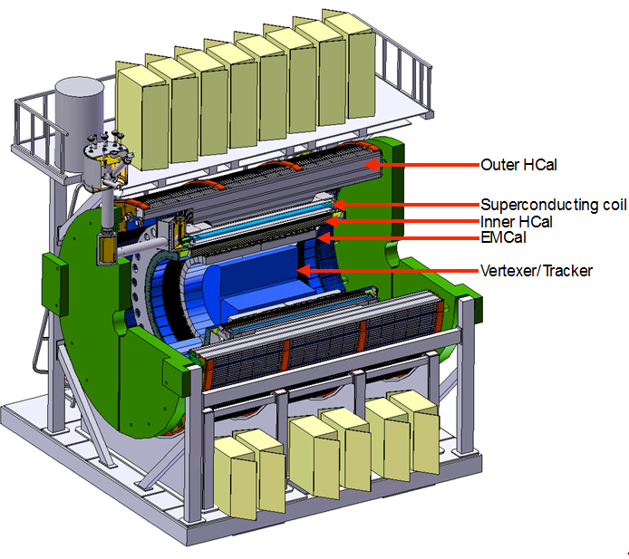
Sphenix Detector
Comprised of six main parts, the Vertexer, tracker, the EMCAL, the Inner HCAL, the solenoid, and the Outer HCAL
EMCAL measures the energy of electrons and photons
HCAL measures the energy of hadrons
Assisted with the Inner HCAL assembly, testing, and calibration while at BNL

Slide 4
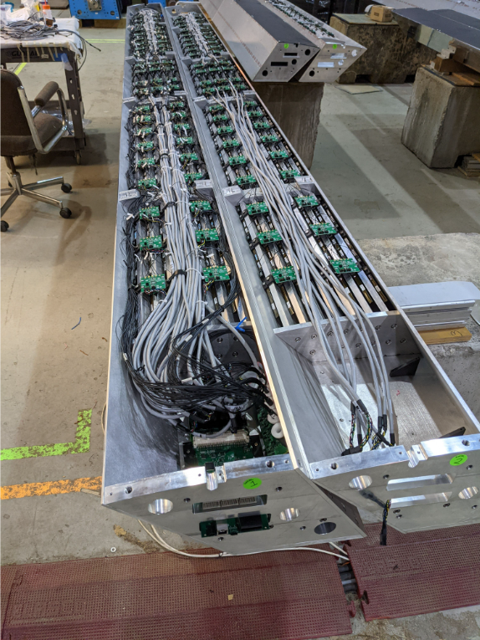
Inner Hcal
Comprised of 32 “sectors” in circular pattern
Each sector is a 6.4m long aluminum structure comprised of aluminum sheets with 9mm slits between to allow the placement of scintillating tiles
Either end contains the electronics for signal and power as well as the test LEDs

Slide 5
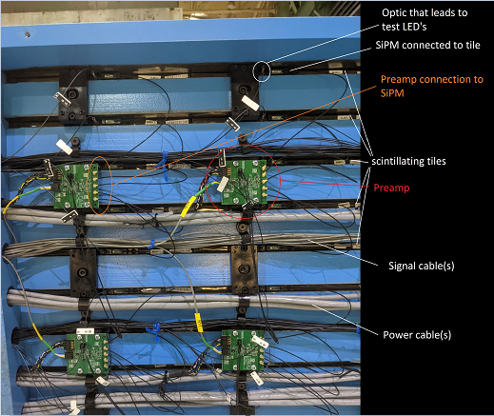
Inner Hcal Hardware
Scintillating tile, silicon photo multiplier (SiPM), and preamp
Four tiles with SiPM’s combine at a preamp to form a ‘tower’
Inner HCAL sectors have 48 total towers
Signal cable, power cable, and optic cable to the test LED
Test LEDs carried by fiber to tiles
4 test LEDs, a different one for each tile of the tower

Slide 6
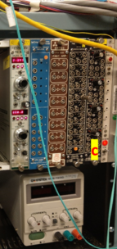
HcAL TESTINg
Test HCAL to ensure all towers are functioning and to calibrate
Use DAQ (Data Acquisition) machine to run tests
DAQ machine controls the bias voltage of the SiPMs, the test diode voltage, test pulse, triggers, and converts the signal voltages into ‘ADC’
The DAQ machine has three main tests:
-LED test to test if each SiPM is responding
-Cosmics which gather cosmic ray events for calibration
-LED scan which runs the LED test at varying diode voltages

Slide 7
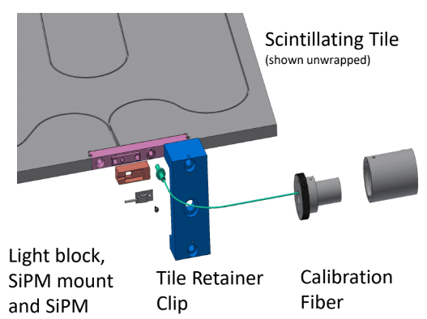
LED test
Test LEDs are powered to a DAC value one at a time
Test LEDs are located on the ends of the sector
Light from LED is split to all scintillating tiles via fiber cables
LED light is measured directly from the PIN diode
Light from LED is injected into tile
SiPM responds to this light as a distribution in ADC units
Test quickly shows if tiles, preamp, or test LED are functioning correctly

Slide 8
LED test
When performing LED tests we can quickly identify when parts are not working properly, as the test below shows
Histogram of LED 2 response for entire sector

Slide 9
LED Scan
Same function as LED test
During a LED scan the DAQ machine incrementally increases each LED’s diode voltage
DAQ machine starts with DAC value of 1600 and increases by 100 DAC after each LED is injected
Total of 7 different DAC values

Slide 10
LED Scan
The gain of the SiPM’s will change due to temperature, radiation damage or other unknown factors
Tracking this gain change is essential to understanding the physics signal from the detector
The change in SiPM gain should be a factor determined by $\frac{\frac{LED(t_{0})}{PIN(t_{0})}}{\frac{LED(t)}{PIN(t)}}$ or
$$ADC\left(t_{0}\right)=ADC\left(t\right)\frac{\frac{LED(t_{0})}{PIN(t_{0})}}{\frac{LED(t)}{PIN(t)}}=ADC(t)\frac{LED(t_{0})}{LED(t)}\frac{PIN(t)}{PIN(t_{0})}(1)$$
Where ADC is our physics signal, LED is the SiPM response to the test LED, and PIN is the signal of the Pin diode, $t_{0}$ is when the detector is calibrated, and t is some later time

Slide 11
LED Scan
From this, $\frac{LED(t_{0})}{LED(t)}$ would track the change in SiPM response, assuming the LED is stable
$\frac{PIN(t)}{PIN(t_{0})}$ would track the LED luminosity
To understand the gain change we must understand how the SiPM’s response to the test LED changes as the PIN diode changes

Slide 12
Method
During LED scan DAQ machine outputs the PIN diode information as well as the SiPM response in log file for each different LED intensity
Developed macros in C++ that can be processed in root to extract desired data
SiPM response as distribution in ADC
PIN diode is a single peak value response
Used one macro to obtain the mean response for each SiPM during LED scan and other macro to process this data with the PIN diode data

Slide 13
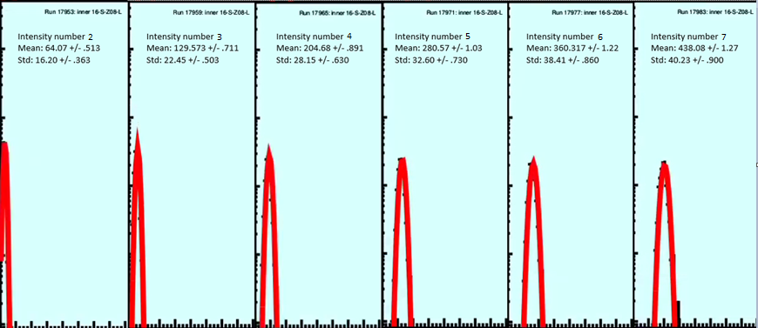
SiPM response to LED
Distribution of SiPM response to test LED 0 for tower 9
Each tile was fit with a gaussian around the peak to extract the mean and error
Number of responses
SiPM response in ADC

Slide 14
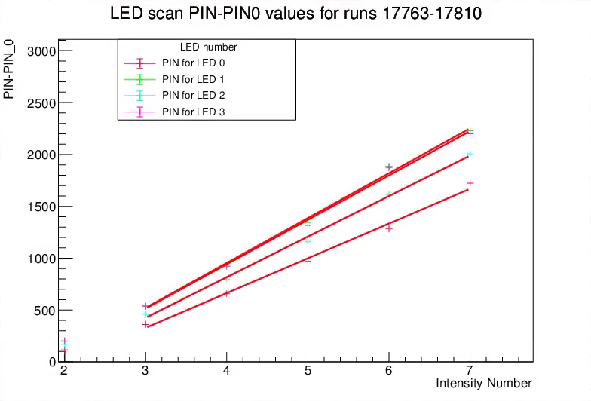
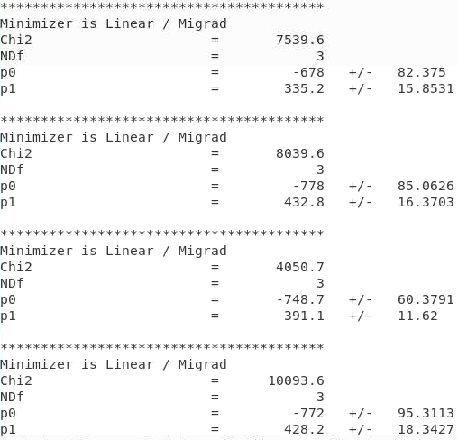
Pin diode vs intensity number
Extracted PIN diode value for each differing intensity and linear fit to line

Slide 15
LED/PIN vs Intensity value
To track the gain change we need to know how SiPM response to the LED changes as PIN changes
If in linear region, LED/PIN vs intensity value would yield a 0 slope line
Took each SiPM peak mean value for tower 9 and then divide by its corresponding PIN value
Removed pedestal value for PIN
Intensity value 1 has too low of an input that the LED does produce light, plots start at intensity value 2 for that reason
Then used a linear fit to a line

Slide 16
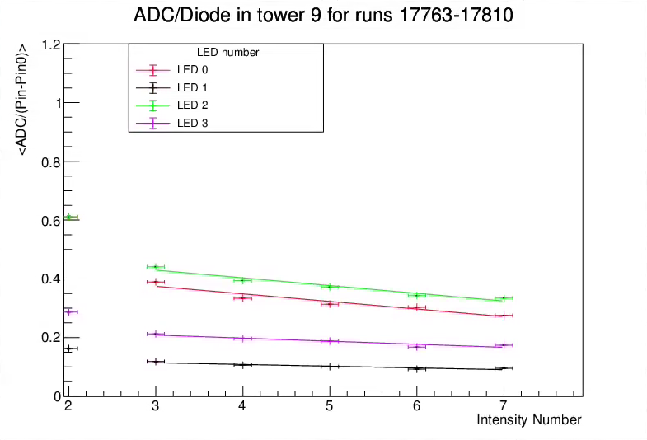
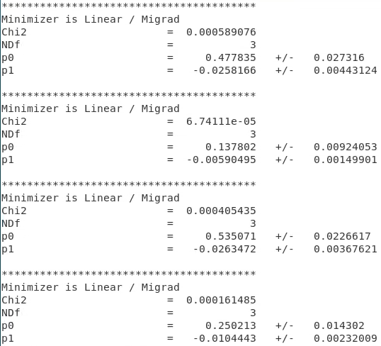
ADC/PIN vs Intensity value
Since at intensity value 2 we are still in non linear region, fit for values 3-7
LED 0
LED 1
LED 2
LED 3

Slide 17
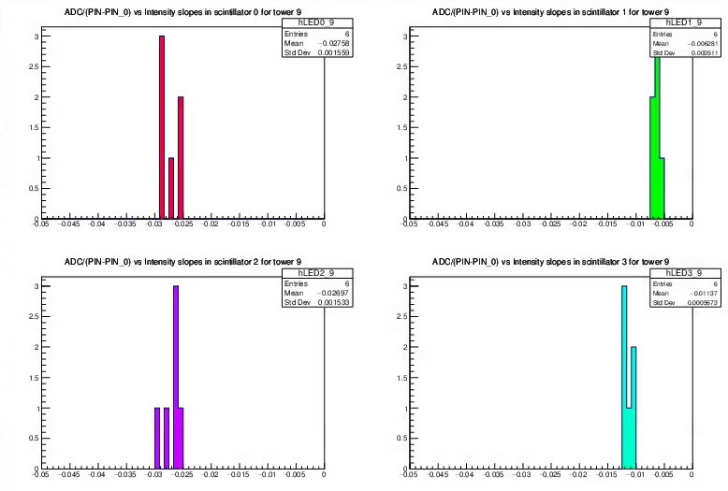
ADC/PIN vs Intensity value slopes
Histogram of the slopes from a line fit on each intensity scan (6) for each LED (0-3)

Slide 18
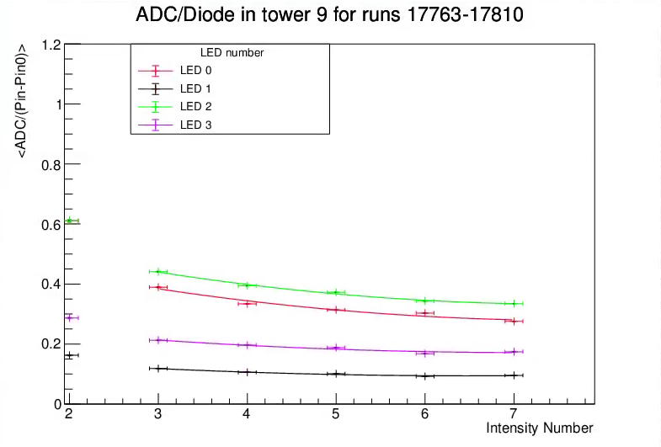
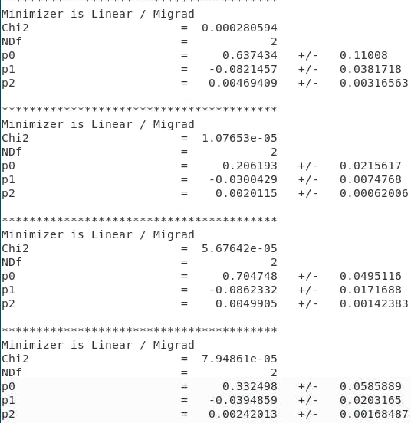
SiPM/PIN vs Intensity value
Since in non-linear region, fit to quadratic instead
LED 0
LED 1
LED 2
LED 3

Slide 19
Conclusion
With a non-zero slope present it is evident that the tile output is not linear vs the DAQ setting
Since PIN vs intensity number is linear, the negative correlation between LED/(PIN-PIN_0) is most likely caused by the efficiency of the tiles decreasing
However, the quadratic fit is strong for the LED/(PIN-PIN_0) suggesting we can use this correlation to calibrate our gain change function

Slide 20
Questions?

