Slide 1
WORKing Examples FWALL @ HADES EPD @ STAR
Lukáš Chlad^{1,2}
¹Nuclear Physics Institute of the CAS
²Faculty of Nuclear Sciences and Physical Engineering of the CTU

Slide 2
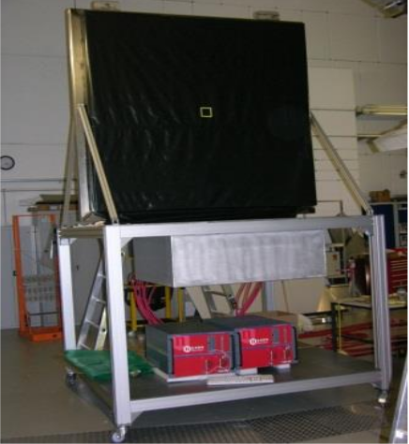
HADES FORWARD WALL
Located 7m downstream from the target region (polar angle between 0.33° and 7.17°)​
Linear dependence of signal amplitude ​on fragment charge

Slide 3
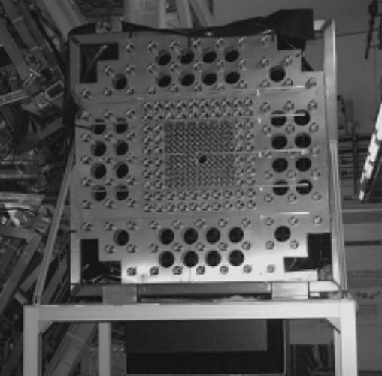
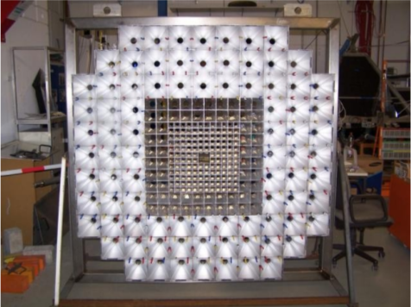
Design
Scintillator hodoscope (depth ~2.5 cm) 140 small cells (4x4 cm²)
64 middle cells (8x8 cm²)
84 large cells (16x16 cm²)
https://doi.org/10.1134/S0020441214020146

Slide 4
Performance
https://doi.org/10.1134/S0020441214020146
Time resolution ~ 700 ps
Z=1
Z=2
Z=3
Fragments charge identification
Z=4
Z=6
Z=8
Z=10
Z=5
Z=7
Z=9

Slide 5
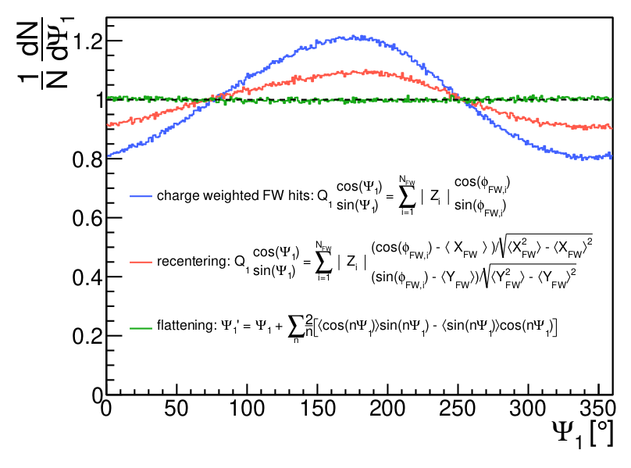
Event plane determination
Arxiv 2208.02740
Effects of non-uniform acceptance / tilt of beam PRC 55 (1997) 1420

Slide 6
Centrality determination
Usually, HADES is using N_{hit} as a variable defining the centrality classes
But in case of (net)proton number fluctuation one needs to avoid as much autocorrelations as possible.
It is to define centrality classes in terms of bins of summed charges in FWall.
https://doi.org/10.1103/PhysRevC.102.024914

Slide 7
Centrality determination
https://doi.org/10.1140/epja/i2018-12513-7
https://doi.org/10.1103/PhysRevC.102.024914

Slide 8
Centrality determination
Recent work on using FWall charge distribution with Machine Learning
Comparison to different models and standard method with MC Glauber with N_{TOF+RPC}
https://doi.org/10.1134/S1063779622020897

Slide 9
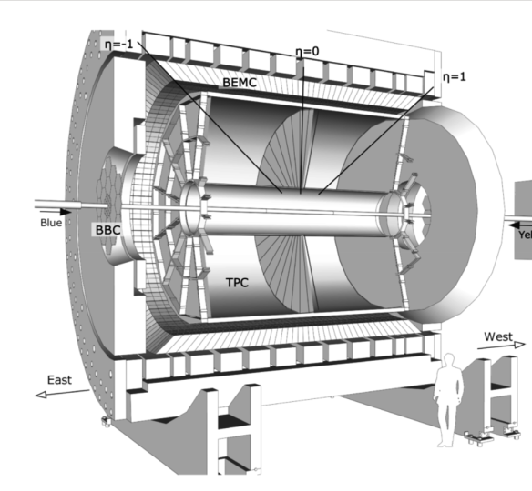
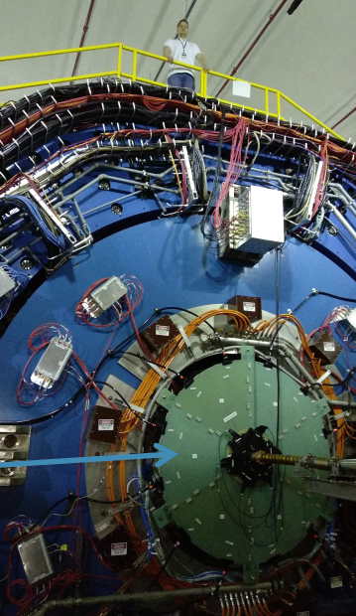
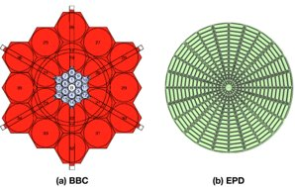
Event plane detector @ STAR
Replaced original BBC in 2017 (within STAR forward physics upgrade)
Measures charged particles emitted in the forward and backward directions, at angles 0.7◦ < θ < 13.5◦
https://doi.org/10.1016/j.nima.2020.163970

Slide 10
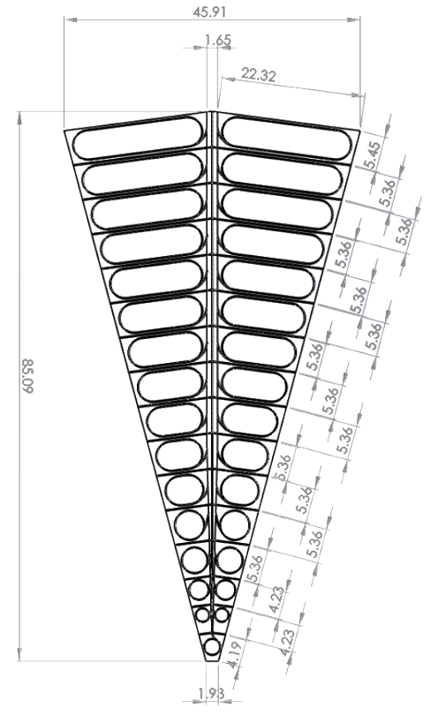
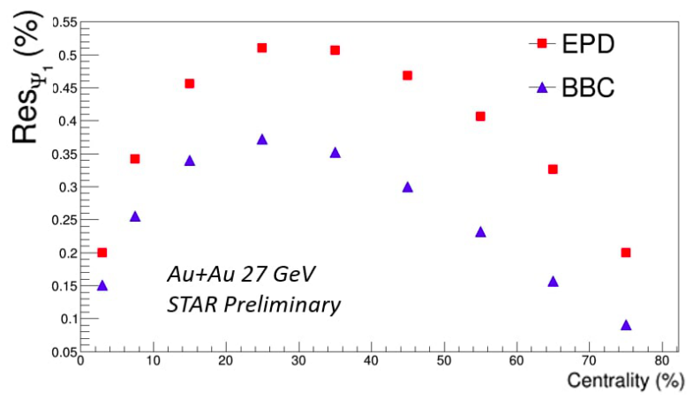
Design
Replacement of original BBC
Inner structure
Of EPD
Beam to Beam Counter used for multiplicity measurement (was used for triggering purposes)
In principle could be as well used to determine EP but with quite bad resolution
12 supermodules (1 is highlighted in figure) covering 30 deg. divided into 31 cells, disk radius 0.9m, hole of 4.6cm
1.2cm thick plastic scintillator read-out with wavelength shifter and optical fiber which that guides the light to SiPM

Slide 11
Performance
Time Resolution
Centrality purity
(18.6 cm) / sqrt(2)c ≈ 0.44 ns

Slide 12
THANK YOU for your attention !!

Slide 13
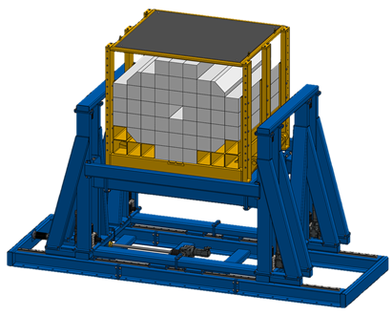
Projectile spectator detector
"The main purpose of the PSD is to provide an experimental measurement of a heavy-ion
collision centrality and orientation of its symmetry plane. Precise event-by-event estimate of these basic
observables is crucial for many physics phenomena studies to be performed by the CBM Collaboration.
The PSD is a compensating lead-scintillator calorimeter* designed to measure the energy distribution
of the projectile nuclei fragments (spectators) and forward going particles produced close to the beam
rapidity. "
*compensating means the same respons to electromagnetic and hadronic shower, using the sandwich Pb/Scint ratio 4:1

Slide 14
Design
44 modules
Design Requirements
How to fullfill them?
Spectators detection in the beam energy range of E_{b} = 2 − 35 AGeV.
Operation at beam intensities up to 10⁹ Au ions per sec.
Reaction plane determination with an accuracy better than 40 degree.
Determination of collision centrality classes with an accuracy better than 10%.
Large area ~ 1.5x1.5 m²
σ_{E}/E < 60%/sqrt(E[GeV])
Granularity 20x20 cm² (4 times smaller module size did not have significant improvement on EP resolution)
Radiation hard photon detector with high-rate capability (Micro-Pixel Avalanche Photodiod)
60 Pb+Scint pairs divided into 10 individually read-out sections
~ 6 interaction lengths

Slide 15
Performance in sim
Centrality determination
Event plane resolution

Slide 16
Performance @ NA61
Energy resolution
centrality
Event plane resolution
https://doi.org/10.22323/1.347.0195
https://doi.org/10.1016/j.nuclphysa.2018.10.058

